Slide 1
COVID-19 and RAAS Passage Walkthrough
By Siddharth Venigalla
*Disclaimer* - I do not own the rights to any of these images, all images are cited

Slide 2
Icebreaker
What was the most fun you had over the summer?

Slide 3
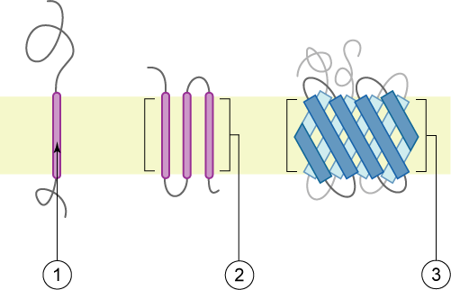
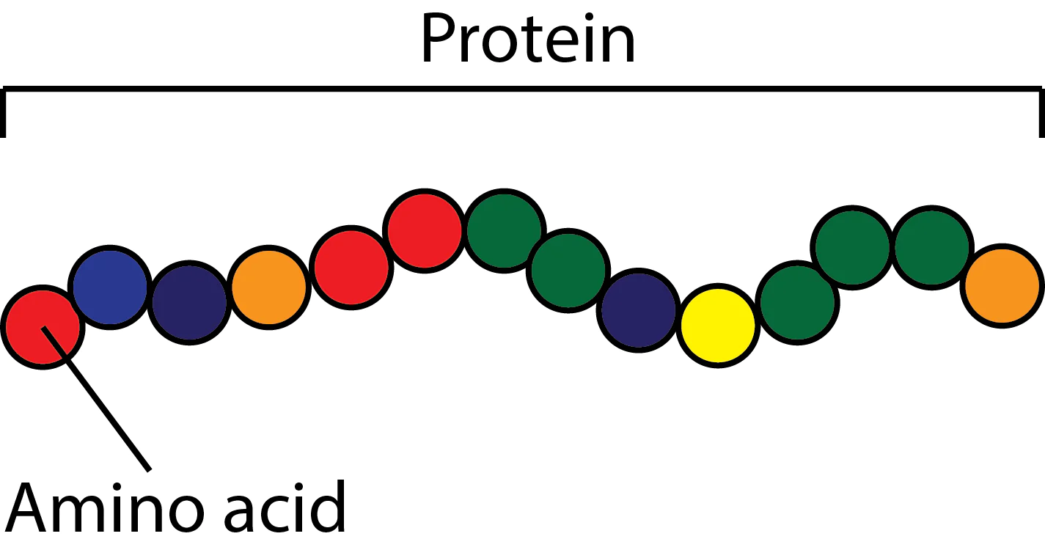
A transmembrane protein passes through the cell membrane
It has residues inside the cell membrane and residues (amino acids) on either side of the cell membrane
A protein is a chain of amino acids and for a transmembrane one some cross the membrane
Proteins also have different regions responsible for different things these are known as protein domains
(Wikipedia)

Slide 4
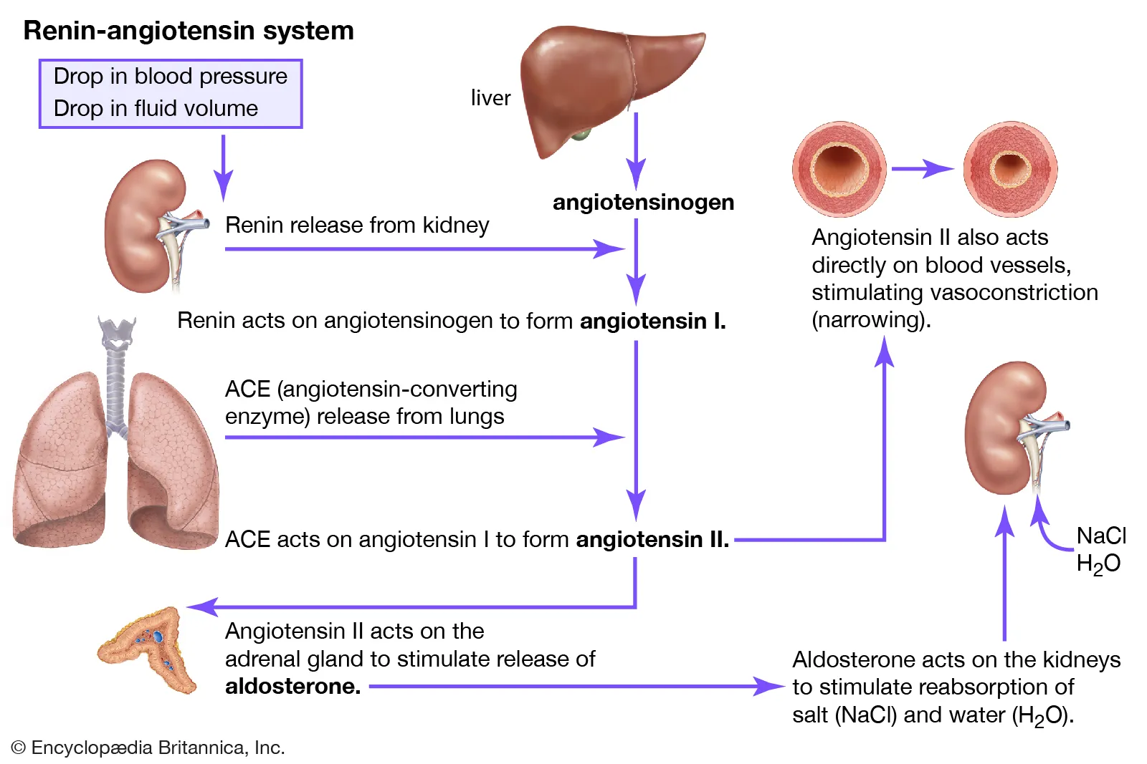
When your body senses low blood pressure, renin is released from your kidney and leads to angiotensinogen from the liver to be cleaved into ANG I and ACE from the lungs cleaves it to ANG II which increases aldosterone
Aldosterone can act on the blood vessels to make them constrict and make your blood pressure rise
It can also lead your kidneys to reabsorb more salt and water
More water means higher blood pressure… imagine more blood pounding against the walls and higher pressure
(Encyclopedia Britannica)

Slide 5
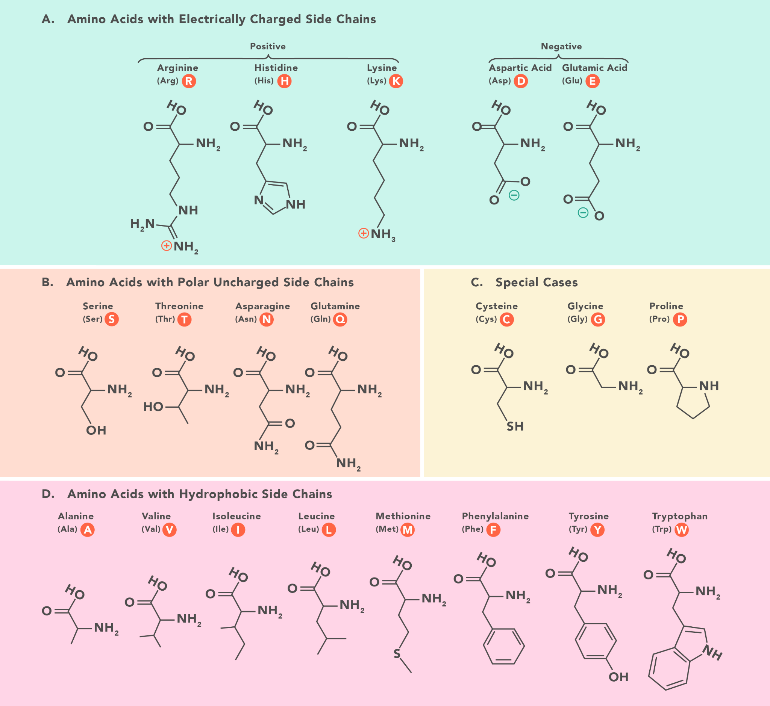
Amino acids come in different types… hydrophobic (non polar), polar and charged
Hydrophobic amino acids like to interact with other hydrophobic acids and polar and charged amino acids like to interact with each other
Proteins bind to each other due to interactions between their amino acids
A mutation from a polar to hydrophobic amino acid in a protein could lead to a higher binding affinity if for example it binded to the other protein via hydrophobic interactions

Slide 6
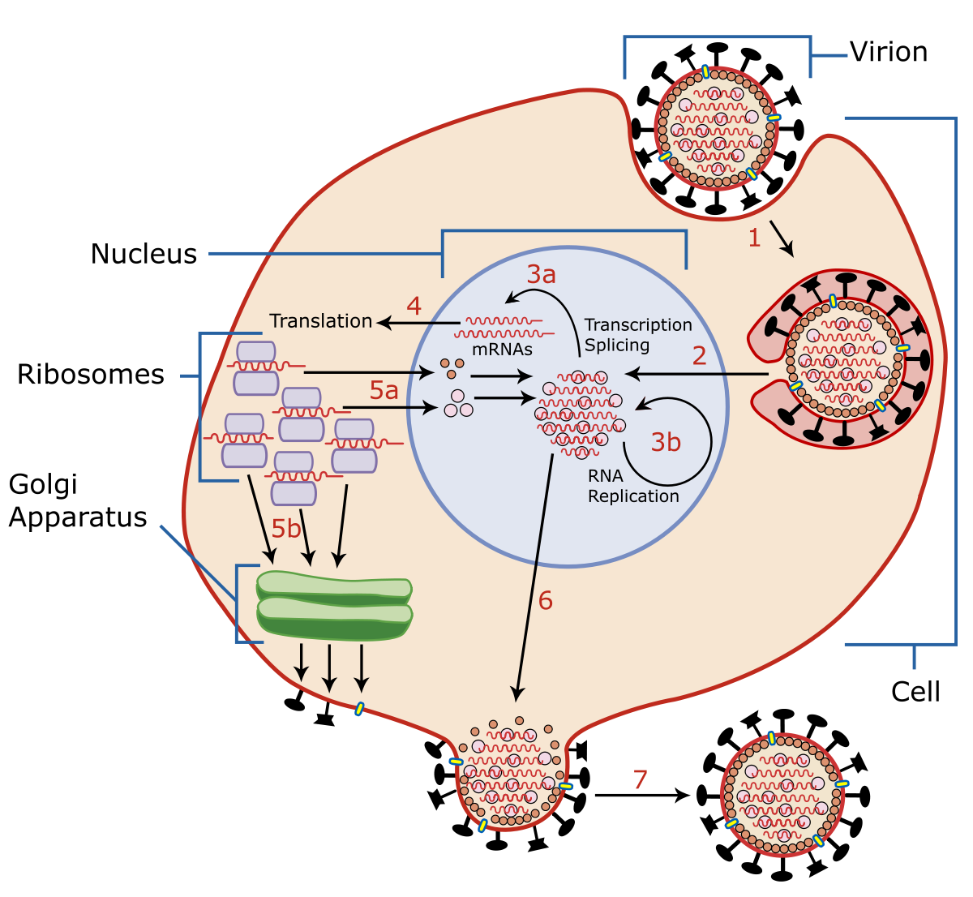
Virus life cycle (can differ based on virus)
Virus binds to receptor of cell and membrane fuses to let virus enter cell
Virus genetic material (can be DNA or RNA) is released
If DNA goes to nucleus where it is transcribed to RNA
If RNA it can be translated to proteins by ribosomes and copies of the RNA can be made by the viral RNA polymerase encoded by the RNA (exception for retrovirus)
The viral copies eventually burst the cell

Slide 7
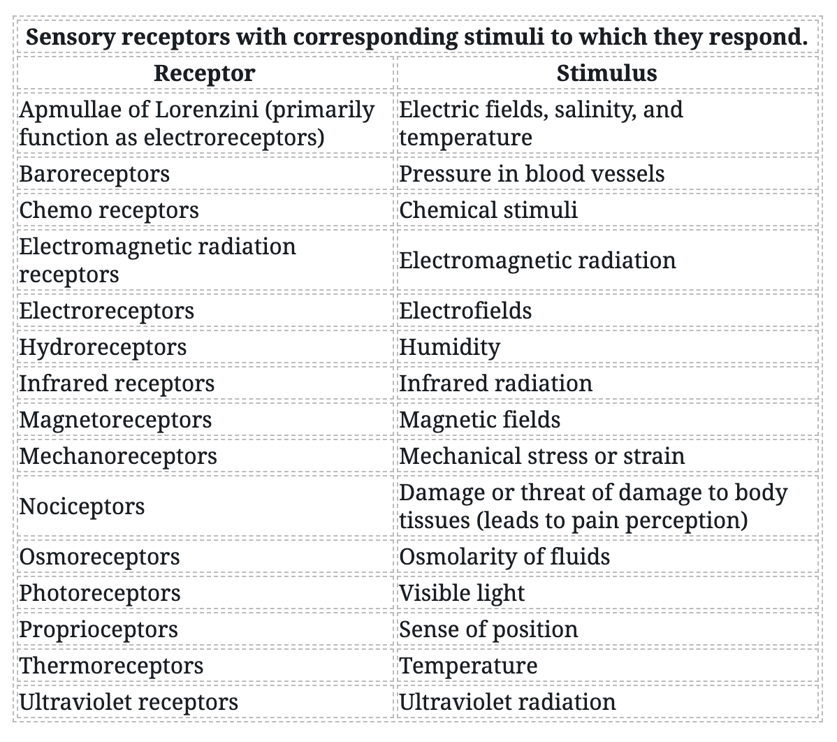
Know the different type of receptors in the body
Baroreceptors are for pressure
Thermoreceptors are for temperature
(Jack Westin)

