Slide 1
MCAT MAX
3/27/23

Slide 2
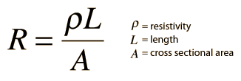
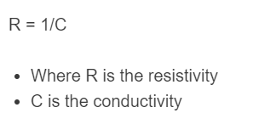
Resistance and Resistivity
Resistance = how much electrons don’t want to flow, depends on the wire dimensions & material
Resistivity = a property of every material describing how much electrons don’t want to flow.
Resistance is lowest when the wire is short and fat.
Think about highways and traffic jams.
Conductivity is the opposite of resistivity.

Slide 3
Bone Structure

Slide 4
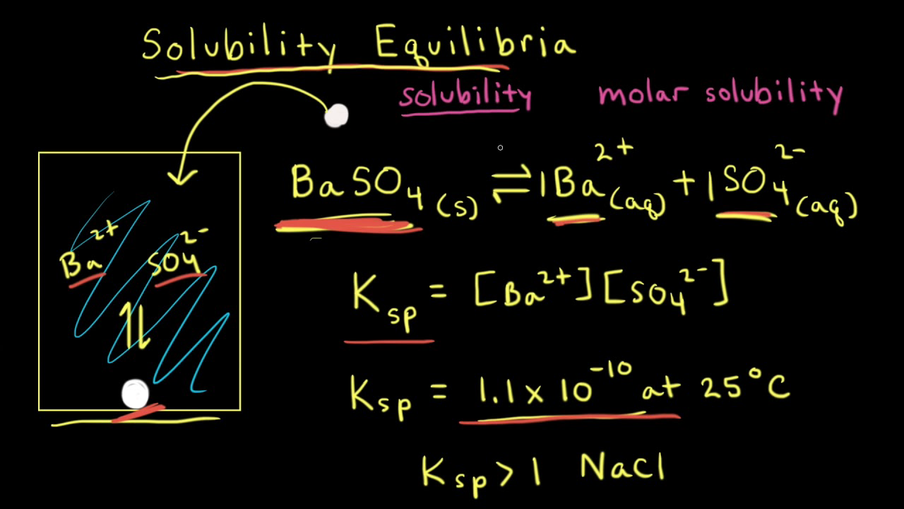
Solubility Constants
K_{sp} = solubility product constant. Lets you calculate how much salt you can add to make a saturated solution.
Higher K_{sp} = more soluble.
Lower K_{sp} = less soluble.
Assume K_{sp} of BaSO₄ is 1 x 10⁻¹⁰.
What’s the concentration of [Ba²⁺] in a saturated BaSO₄ solution?

Slide 5
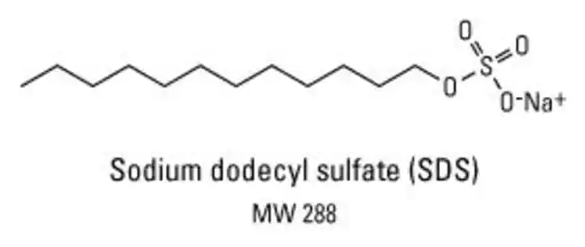
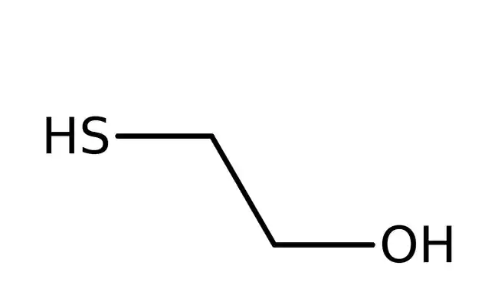
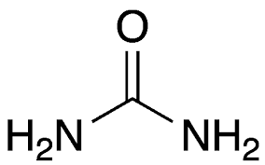
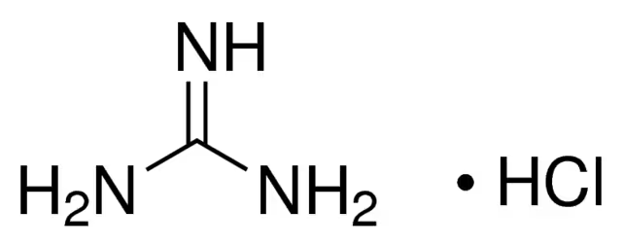
Denaturing Agents
Denaturing agents = stuff that can cause a protein to fall apart
You should know well what the main denaturing agents are:
Extreme pH (acids and bases)
High temperature & low temperature
Salts (disrupt salt bridges)
Detergents (e.g. SDS)
Beta-Mercaptoethanol (breaks down disulfide bridges)
Urea, guanidine HCl (interferes with H-bonds)
UV radiation
4
Beta-Mercaptoethanol
5
6
6
What amino acid is guanidine “a part of”?

Slide 6
Exam tips
*ABUSE strikethrough feature*
Generally, read passage first before answering questions
For Chem and Bio, try doing discrete first before passage. I knew I would be nervous on test day so I can’t focus on a passage for the first five minutes.
CARS – eliminate anything that’s 5% wrong, even if it’s 95% right.
Know your amino acids – guaranteed 3-5 questions
Every time you do a chem/phys calculation, pay attention to units.
Know your amino acids.
For bio passages with long pathways, I like to organize proteins into 2 teams (more on that in future sessions).

Slide 7
Practice Passage
https://jackwestin.com/daily/mcat-practice-passages/chemical-physical-practice-passages/nerve-grafts-and-scaffolds

