Slide 1
Celiac Disease and Apoptosis Passage Walkthrough
By Siddharth Venigalla
*Disclaimer* - I do not own the rights to any of these images, all images are cited

Slide 2
Icebreaker
What is your all time favorite TV show?

Slide 3
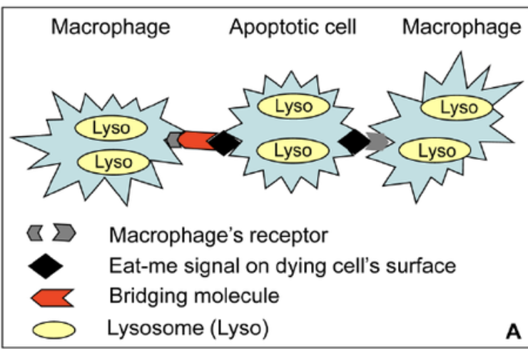
Macrophage, aka “Scavenger Cell”, binds to apoptotic (dying) cells and consumes them via a process called phagocytosis so that the cells are digested through fusion with a lysosome and cleared from the body
Receptors on the macrophage cell membrane are bridged with signaling molecules on an apoptotic cell membrane via a bridging molecule
Macrophages are PHAGOCYTIC, they “EAT” stuff
(Liu et. al, 2013)

Slide 4
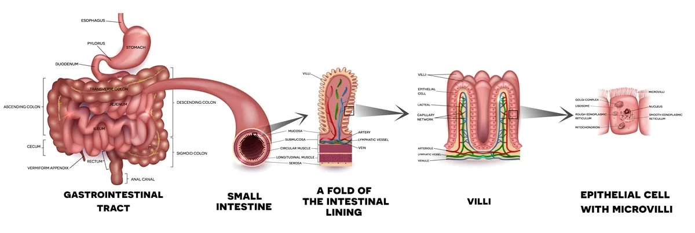
Food moves through the GI tract where it is digested in the stomach and absorbed via the small intestine
The villi are folds in the small intestine that increase surface area so that more nutrients can be absorbed
If you damage the vili, the body can’t absorb nutrients and you experience weight loss

Slide 5
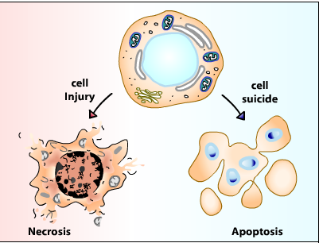
Necrosis is unregulated cell death which is BAD and leads to the leakage of the contents of the cell
This causes the overproduction of inflammatory cytokines which can disrupt the immune system
When macrophages get overwhelmed with apoptotic cells, necrosis can begin to occur and overproduction of cytokines (Interleukins) can happen such as in conditions like Celiac disease
Necrosis can damage tissues and so we want it to not happen by promoting macrophage consumption of apoptotic cells
If we can enhance the macrophage-apoptotic cell connection, we can limit diseases of necrosis and inflammation like those in the lining of the intestine (Celiac disease)
(The Art of Medicine)

Slide 6
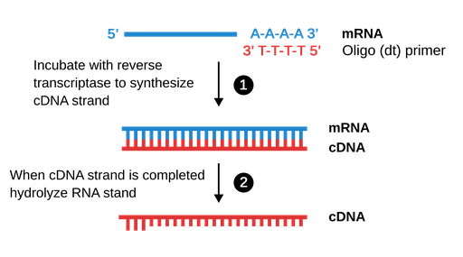
We can quantify the amount of proteins in cells by measuring the amount of mRNA
We do this by reverse transcribing it into cDNA and measuring that
More cDNA means more of that protein
We can measure the proteins in the membranes of the apoptotic cells and the macrophage cells to tell whether a certain treatment aka gluten-free diet enhances phagocytic signaling and prevents necrosis and inflammation
(Labster Theory)

