Slide 1
SCFA and GPR-41 Passage Walkthrough
By Siddharth Venigalla
*Disclaimer* - I do not own the rights to any of these images, all images are cited

Slide 2
Icebreaker
Name
School
What’s your favorite Halloween candy?

Slide 3
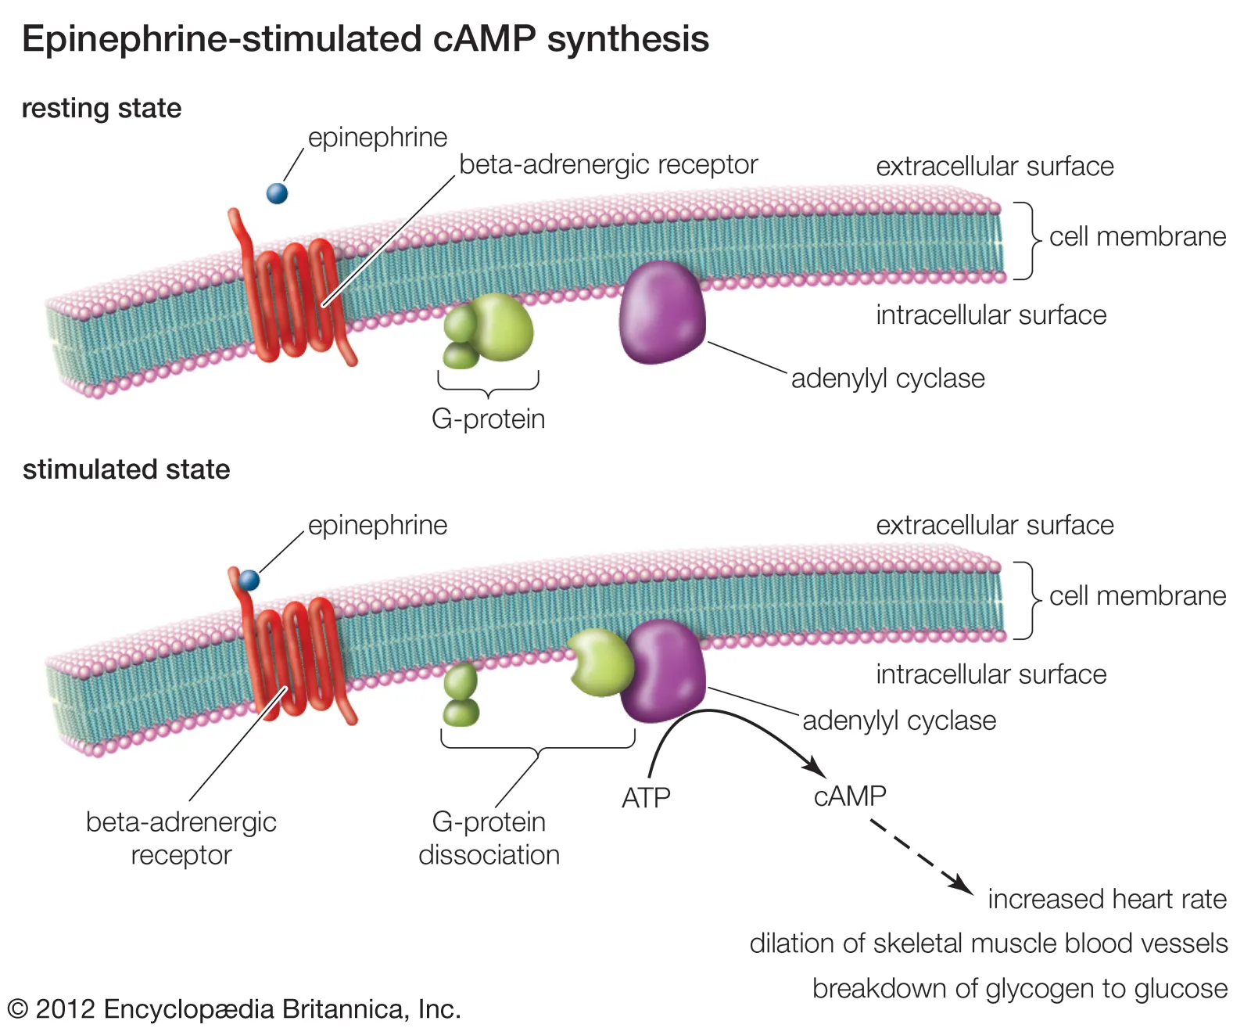
(Creative Proteomics)
Lipid
Signaling molecule
G-Protein Coupled Receptor
Responds to ligand and leads to cell signaling pathway
(Encyclopædia Britannica)

Slide 4
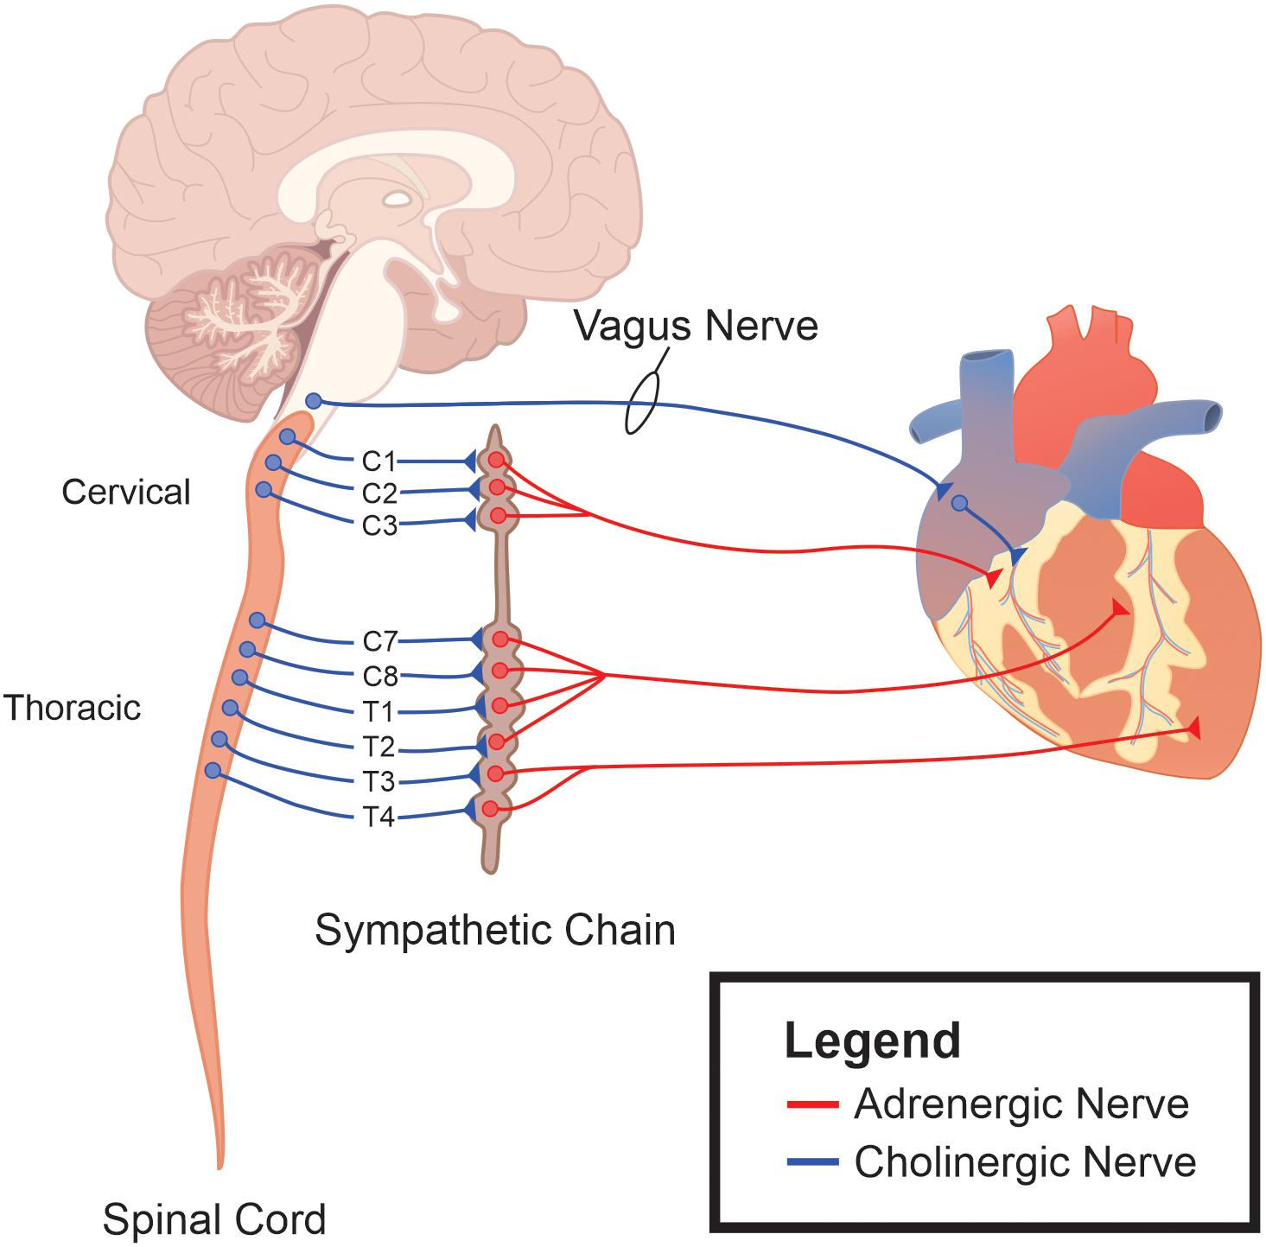
Sympathetic Nervous System
Fight or Flight
Increases your heart rate so you can pump blood to muscles and brain to react to stress
Nervous System (Brain and Spine) Signals to Organs
Preganglionic Neurons
Neuron that synapses (signals) to another neuron in between spine and organ
Postganglionic Neurons
Neuron that synapses directly on organ and receives signal from preganglionic neuron
Parasympathetic Nervous System
Rest and Digest
Decrease in heart rate
(Espinoza et. al, 2021)

Slide 5
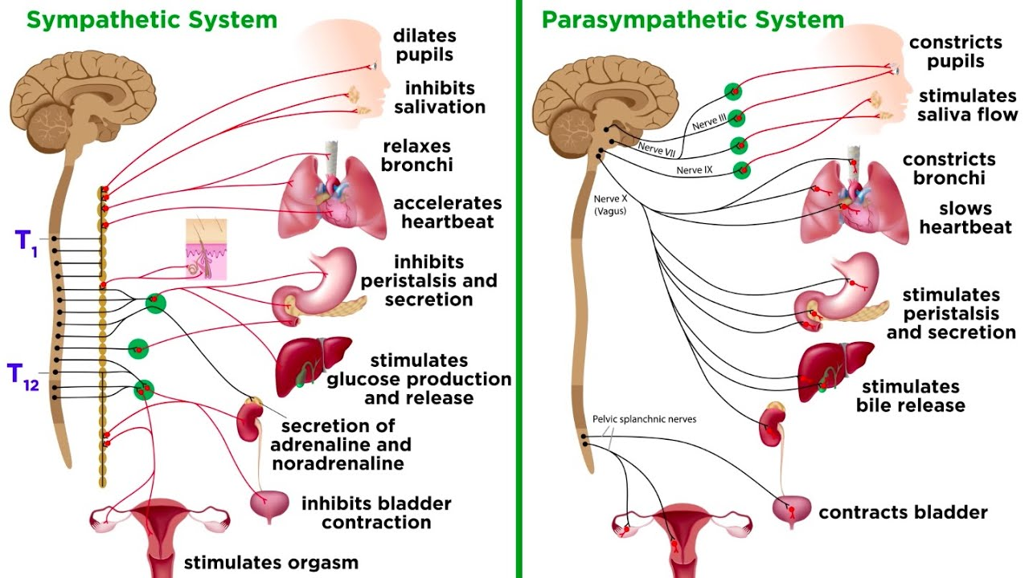
AUTONOMIC NERVOUS SYSTEM
Think autopilot
Two versions: parasympathetic and sympathetic
Opposite functions
One is “fight and flight”
One is “rest and digest”
(Professor Dave)

Slide 6
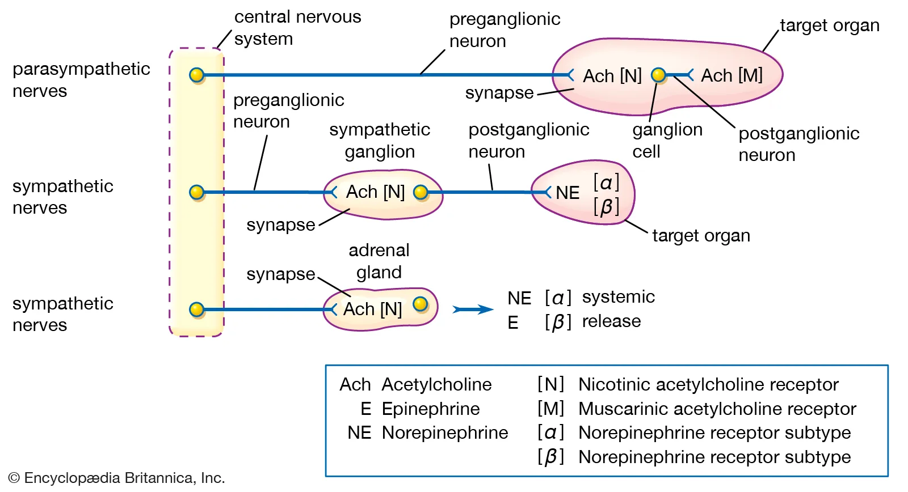
Acetylcholine binds to CHOLINergic receptor
Norepinephrine/Epinephrine binds to ADRENergic receptor
Epinephrine is often called ADRENaline so that is why it is dubbed ADREnergic receptor
The preganglionic neuron releases acetylcholine ALWAYS, this binds to a CHOLINERGIC receptor on the postganglionic neuron
The postganglionic neuron releases norepinephrine which binds to an ADRENERGIC receptor on the target organ in sympathetic, or releases acetylcholine which binds to CHOLINERGIC receptor on target organ in parasympathetic

Slide 7
(GenoWay)
VERY IMPORTANT MCAT CONCEPT
When experimenters knockout a gene for a protein in a mouse, they are trying to see what happens without that protein AKA what is that protein’s function
Experimenters will graph results for heart rate for example for WILD TYPE and KNOCKOUT (KO) mice
By observing what functions are lost, they can deduce what that protein is responsible for

Slide 8
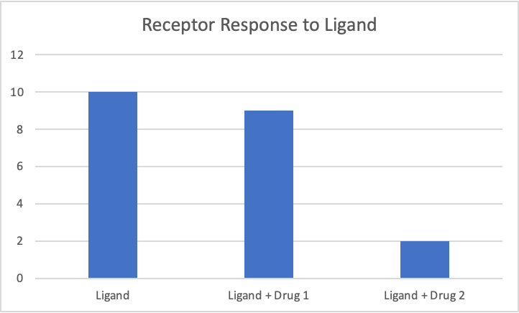
Drugs can mimic the molecules in our body and activate the same receptors (agonist) or they can block the receptors (antagonist)
If you introduce a drug in an experiment along with the normal ligand that usually activates the receptor, and the response goes down compared to the normal ligand then the drug is an antagonist
(Josikins, Psychonaut Wiki)

Slide 9
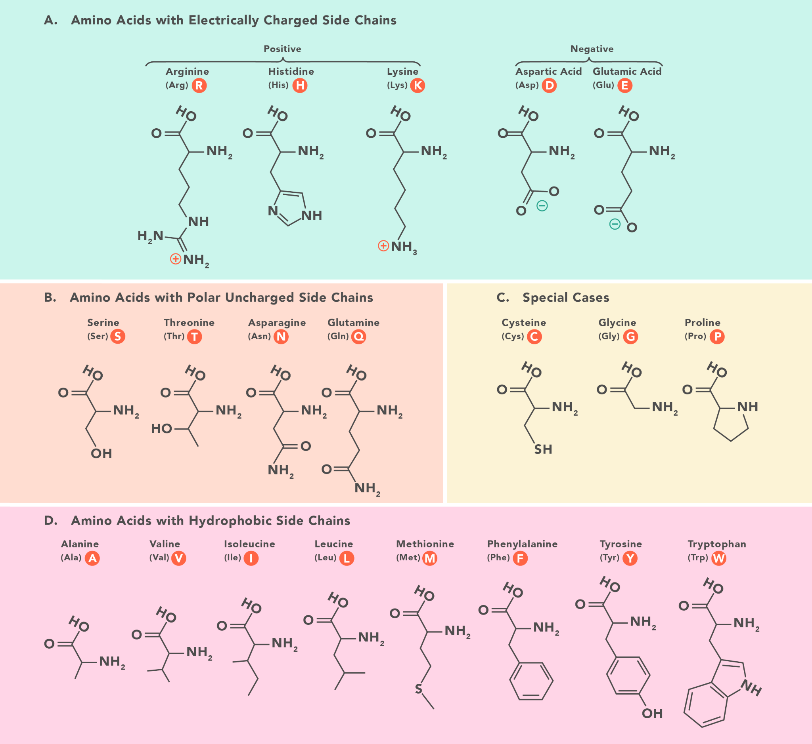
The inside and outside of a cell are watery and favor polar (charged) molecules
Polar amino acids are going to be on the inside or outside of a cell
Nonpolar amino acids will be found in the hydrophobic cell membrane
(Technology Networks)

