Slide 1

DGAT Isoenzymes
Passage Walkthrough
By Andy Shar
*Disclaimer* - I do not own the rights to any of these images, all images are cited

Slide 2
Icebreaker
What is your favorite food?

Slide 3
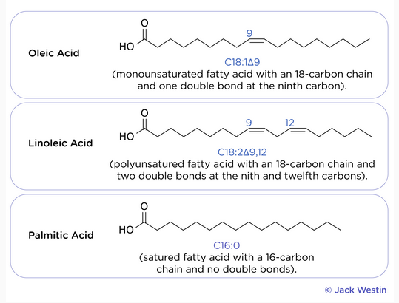
Monounsaturated fatty acids - one double bond
Polyunsaturated fatty acids - more than one double bond
Saturated fatty acids - no double bonds
Given that they’re the same # of carbons long, which of the three:
Has the highest melting point?
Has the lowest melting point?
Is most likely to be solid at room temp?
Is most likely to be liquid at room temp?
(Jack Westin)

Slide 4
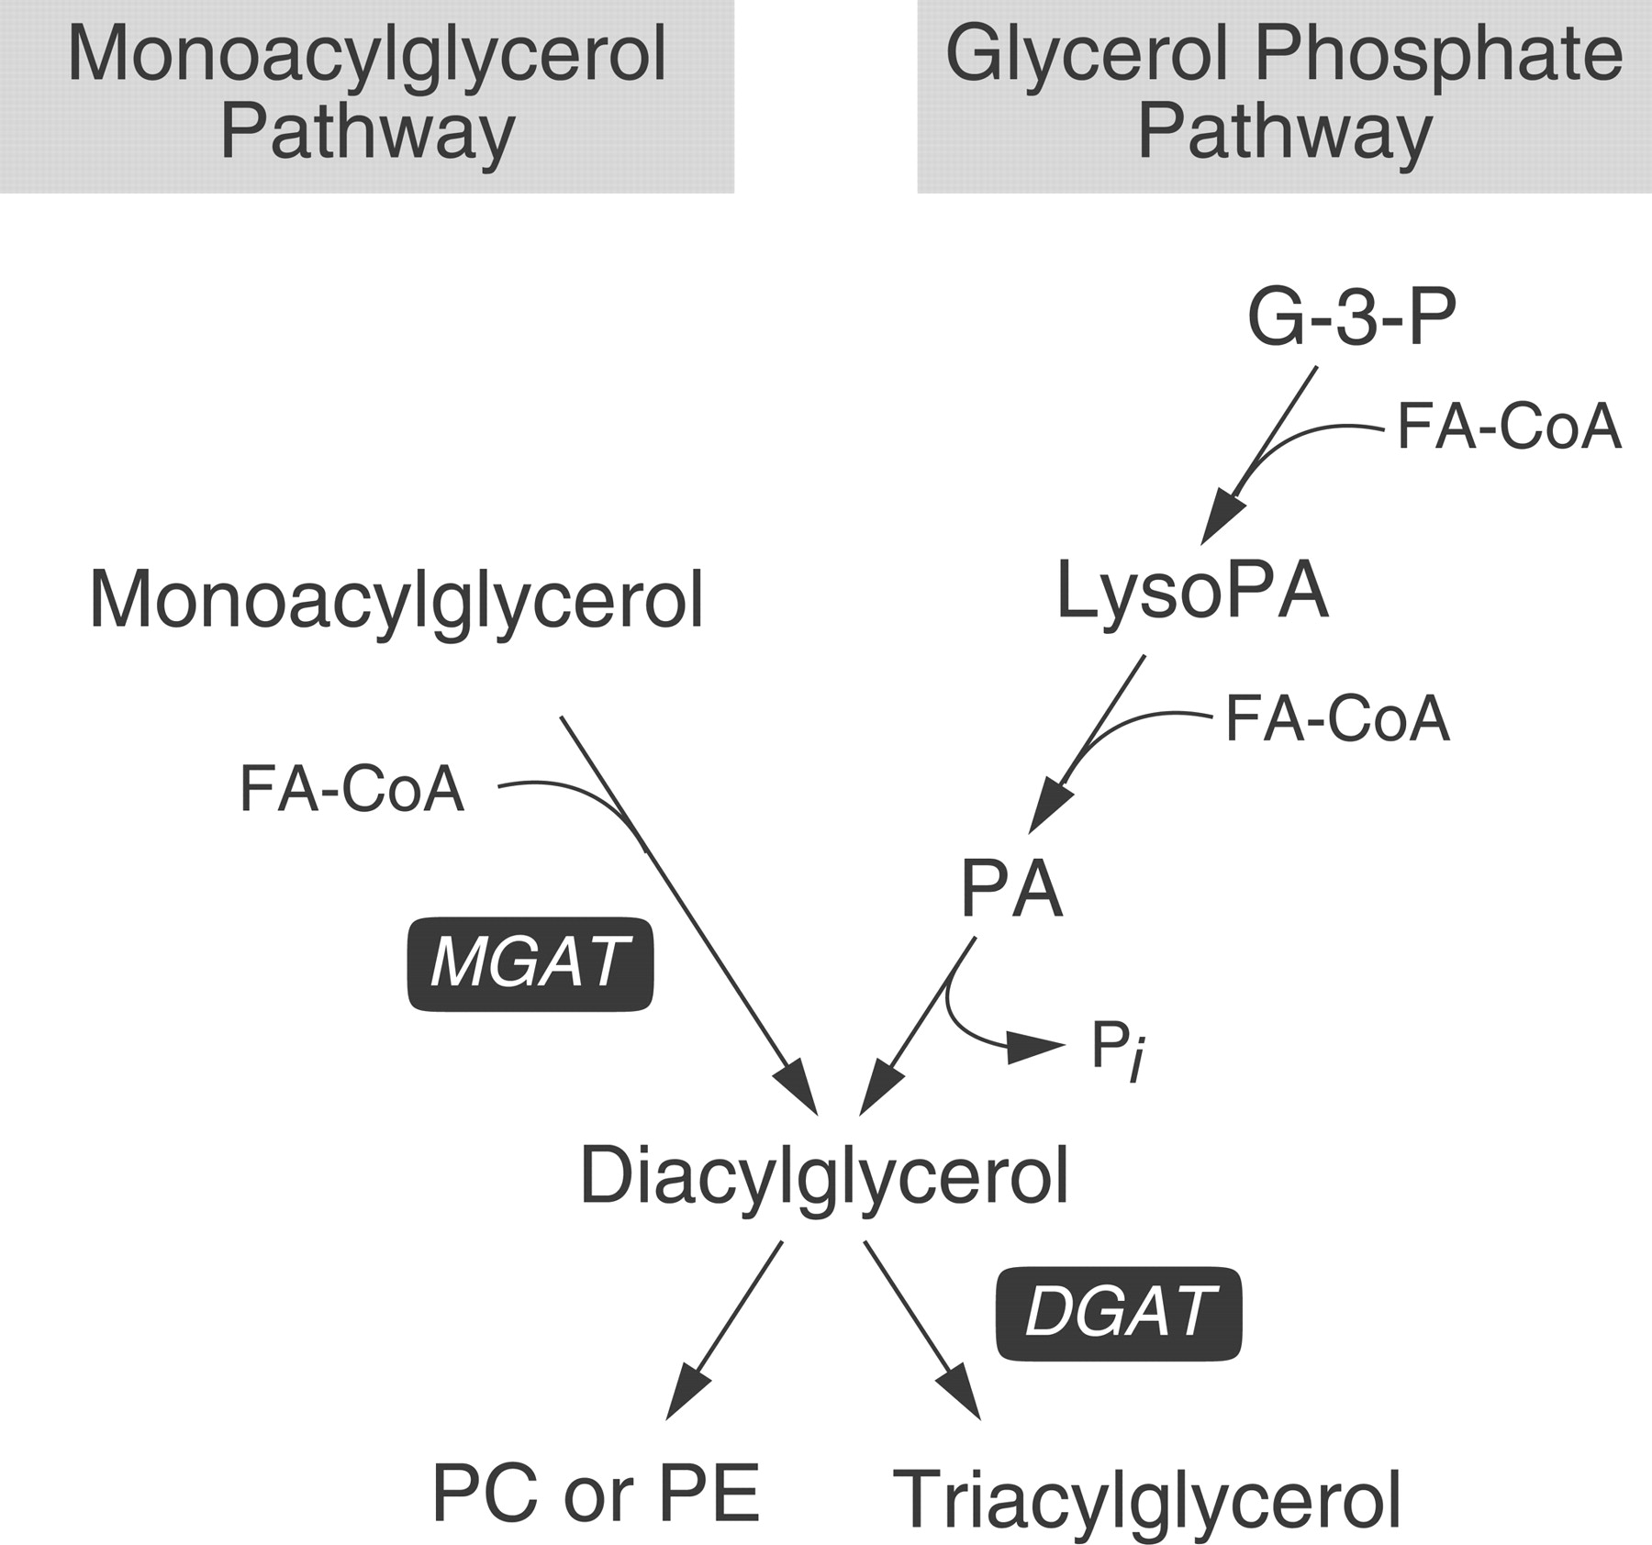
Don’t focus on too much specifics, but the ones in red.
Two pathways to make triacylglycerides (fats): monoacylglycerol pathway and glycerol phosphate pathway
Common intermediate is diacylglycerol
(Yen et al.)

Slide 5
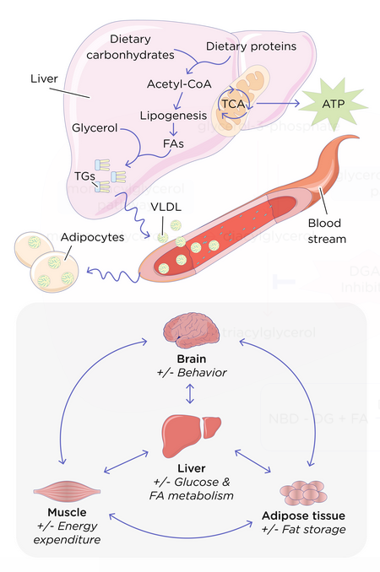
(Jack Westin)
An overgeneralization but something that could be useful: the liver is the primary location for anything metabolism related (glycolysis, glycogenolysis, gluconeogenesis, ketogenesis, etc.).
Lipogenesis: making fats, occurs in liver cells and fat cells (adipocytes)
Lipid storage: occurs in adipocytes
Lipolysis: breaking down fats, occurs in adipocytes

Slide 6




Main Biochem Reaction Types You Should Know for the MCAT
Hydration
Ligation
Isomerization
Oxidation-reduction
Dehydration: A-OH + B-H → AB + H2O
Saponification: Triglyceride + Base → Glycerol + Fatty Acid Salts
Esterification: Carboxylic Acid + Alcohol → Ester + Water

Slide 7
Metabolism Reactions Come in Pairs
There is always a counterpart for every metabolism reaction. You should know the purpose of every reaction here, as well as the part of the body that they occur in:
The reactions shaded in grey take place in all cells of your body!
Glycolysis | Gluconeogenesis
Glycogenolysis | Glycogenesis
Lipolysis | Lipogenesis
Ketolysis | Ketogenesis
Proteolysis | Protein synthesis
Nucleotide degradation (purine & pyrimidine catabolism) | Nucleotide synthesis (purine & pyrimidine anabolism)

