Slide 1
GnRH and Kisspeptins Passage Walkthrough
By Siddharth Venigalla
*Disclaimer* - I do not own the rights to any of these images, all images are cited

Slide 2
Icebreaker
What is your favorite holiday?

Slide 3
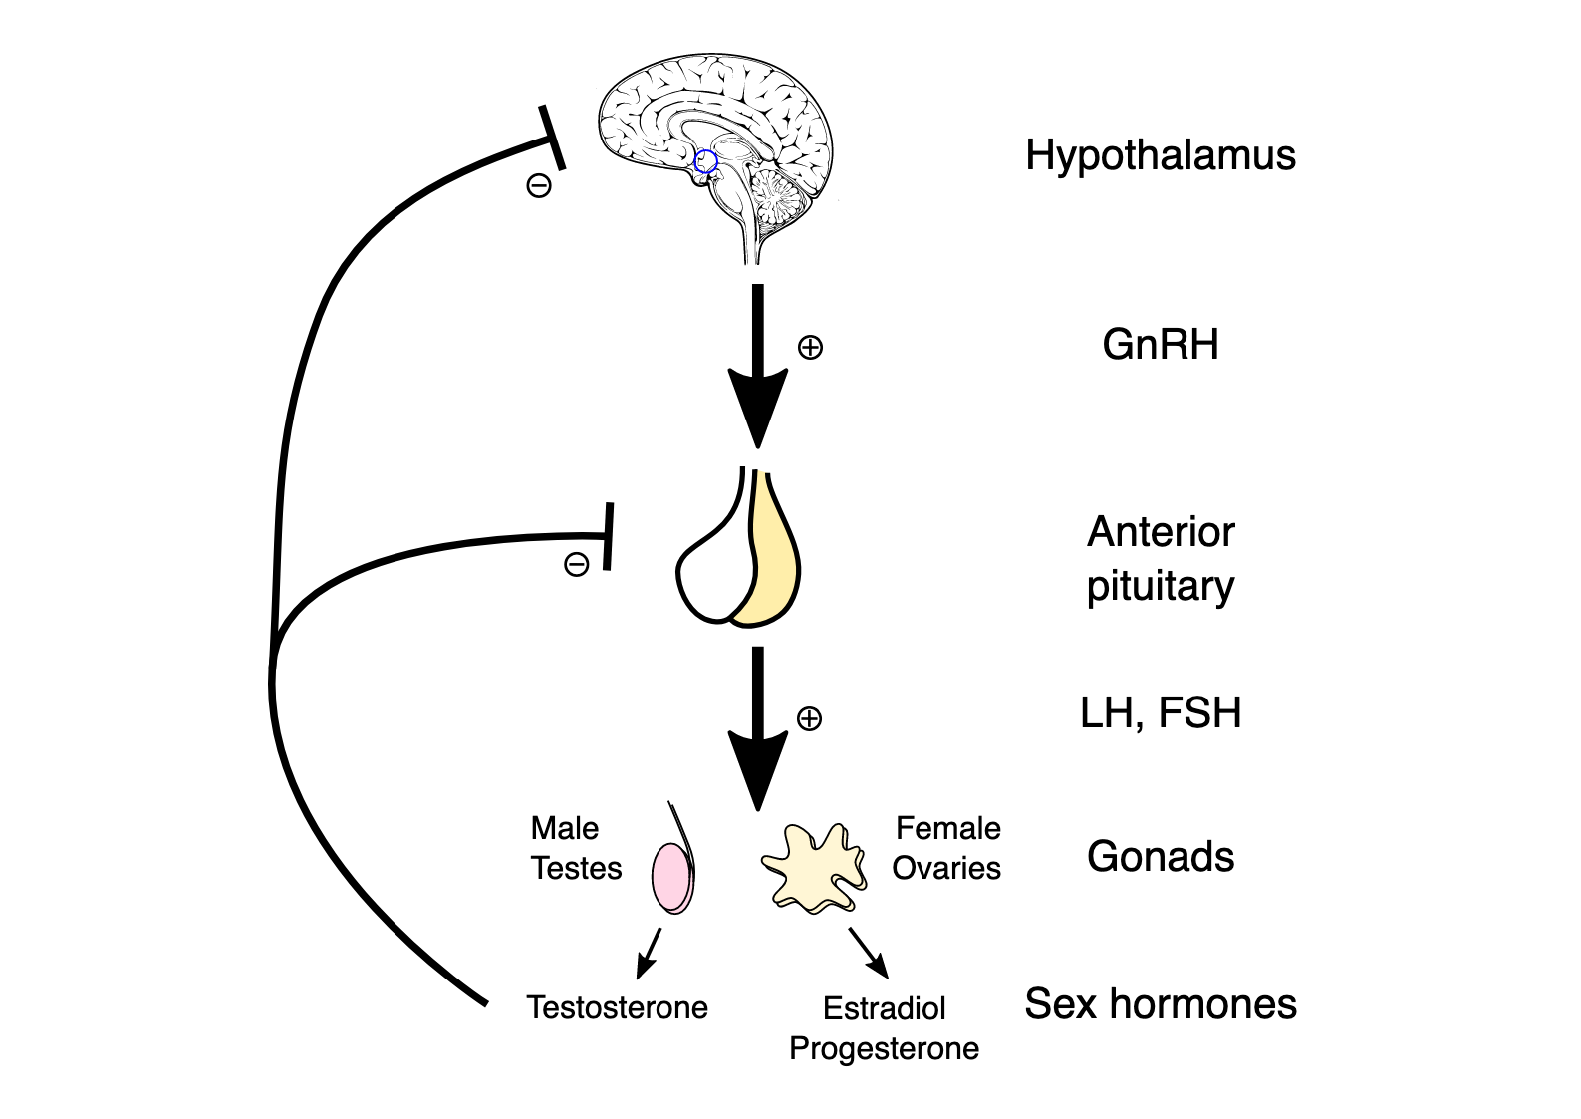
The pathway by which sex hormones like testosterone, estradiol (estrogen) and progesterone are released is called the Hypothalamic-Pituitary-Gonadal Axis
Hypothalamic neurons release hormones e.g GnRH (Gonadotropin releasing hormone) which travel to and act on the anterior pituitary gland which causes it to release hormones e.g LSH and FH (also called gonadotropins) which travel to and act on the sex organs to release sex hormones
LH and FSH act on the testes for males and ovaries for females and cause testosterone or estrogen release respectively
(Wikipedia)

Slide 4
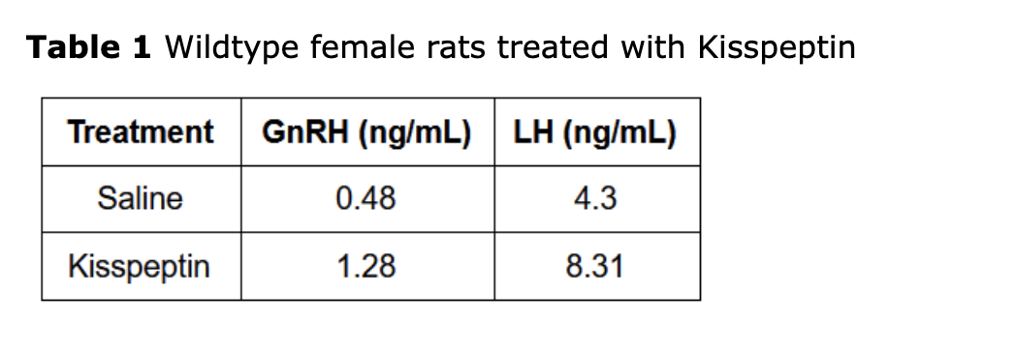
Let’s say we give you a compound Kisspeptin and it can modulate (aka change) the Hypothalamic-Pituitary-Gonadal pathway. How does Kisspeptin affect GnRH levels and LH levels?
We know for a fact that Kisspeptin increases the GnRH levels… BUT
We don’t know the LH level rise is just because of the GnRH rise OR… is it because the Kisspeptin is directly acting to increase LH release
WE NEED MORE INFO!

Slide 5
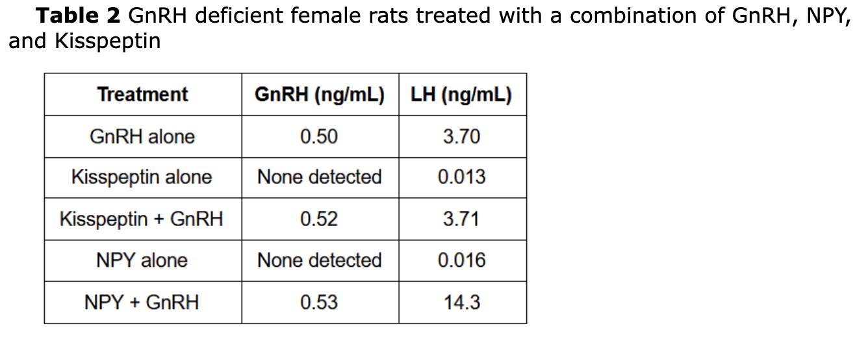
(Jack Westin)
Let’s figure out if Kisspeptin is directly increasing LH levels or is indirectly increasing it by increasing GnRH levels which in turn increases LH levels
Let’s take away the mice’s ability to release GnRH by themselves. Now, Kisspeptin can’t alter GnRH release. If we take away this ability, will LH level still rise? Let’s use “GnRH alone” as a baseline to compare normal LH levels. Here, we add GnRH to these GnRH deficient mice to establish a normal level of LH. When we add Kisspeptin + GnRH, we don’t get any difference in LH levels. What does this mean??
It means that Kisspeptin was never able to go and directly impact LH levels, it was only able to indirectly increase them by increasing GnRH levels

Slide 6
What about NPY?? Is it simply increasing GnRH levels to cause an indirect increase in LH or is it directly acting to increase LH?
Remember it is impossible for the release of these GnRH-deficient mice to be altered. However, when we add NPY + GnRH, the levels of LH rise compared to GnRH alone. We know NPY can’t be increasing GnRH levels to cause this LH increase (mice are mutated). Therefore, NPY must be acting directly to increase LH release.

Slide 7
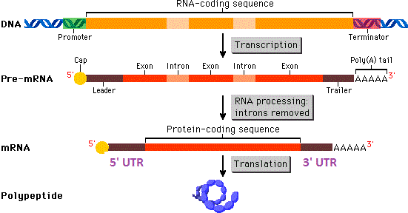
When DNA is transcribed into pre-mRNA, there are exons (coding regions) and introns (non-coding regions)
The introns are spliced out and the exons remain
However, just because nucleotides make it to the final mRNA does not mean that they are going to be translated
The final mRNA copy is going to have 5’ UTR (untranslated region) and 3’ UTR
This genetic code in these regions will never be translated despite technically being an exon and making it to the final mRNA copy
(Socratic)

Slide 8
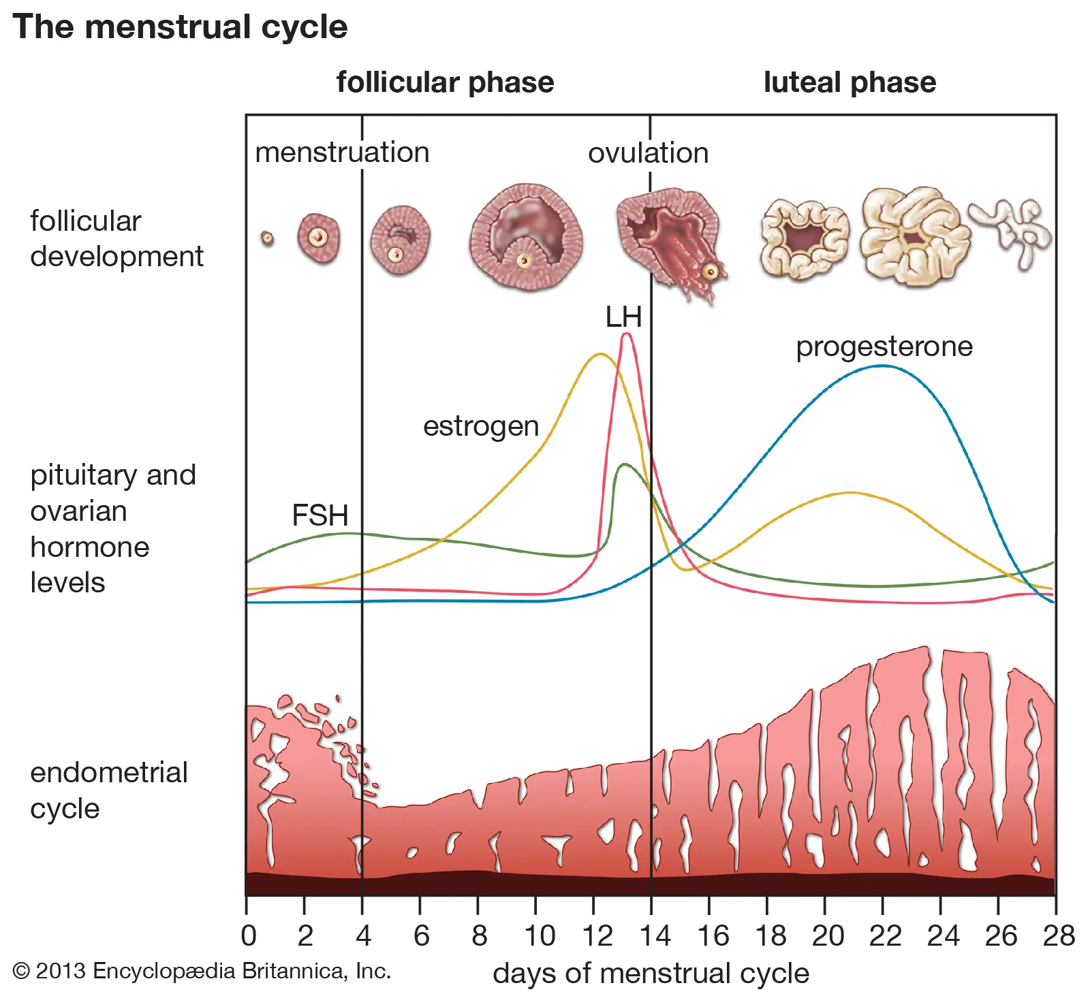
The menstrual cycle is something that you need to know for the MCAT
For simplicity purposes, we divide it into two halves, pre-ovulation (follicular) and post-ovulation (luteal)
The first half of the menstrual cycle is pre-ovulation and is where the egg-containing follicle matures with estrogen and LH levels rising
LH levels and estrogen levels then peak which causes ovulation and the egg to burst from the follicle
The now ruptured follicle forms the corpus luteum and releases progesterone which thickens the uterine lining in preparation for the implantation of blastocyst

Slide 9
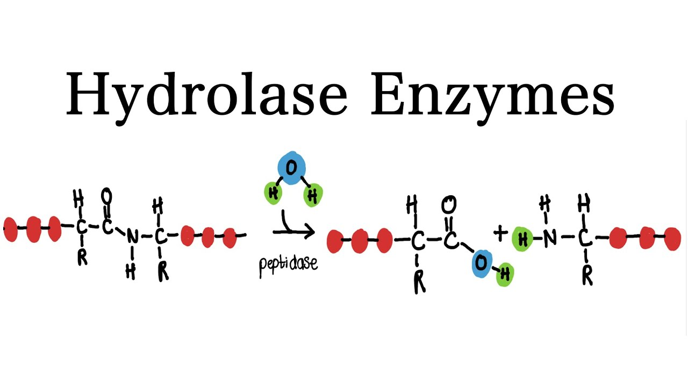
Hydrolase enzymes break down bonds between amino acids by adding water to tear apart proteins

