Slide 1
Toxic Therapeutics Biochem Passage Walkthrough
By Siddharth Venigalla
*Disclaimer* - I do not own the rights to any of these images, all images are cited

Slide 2
Icebreaker
Where are you from?

Slide 3
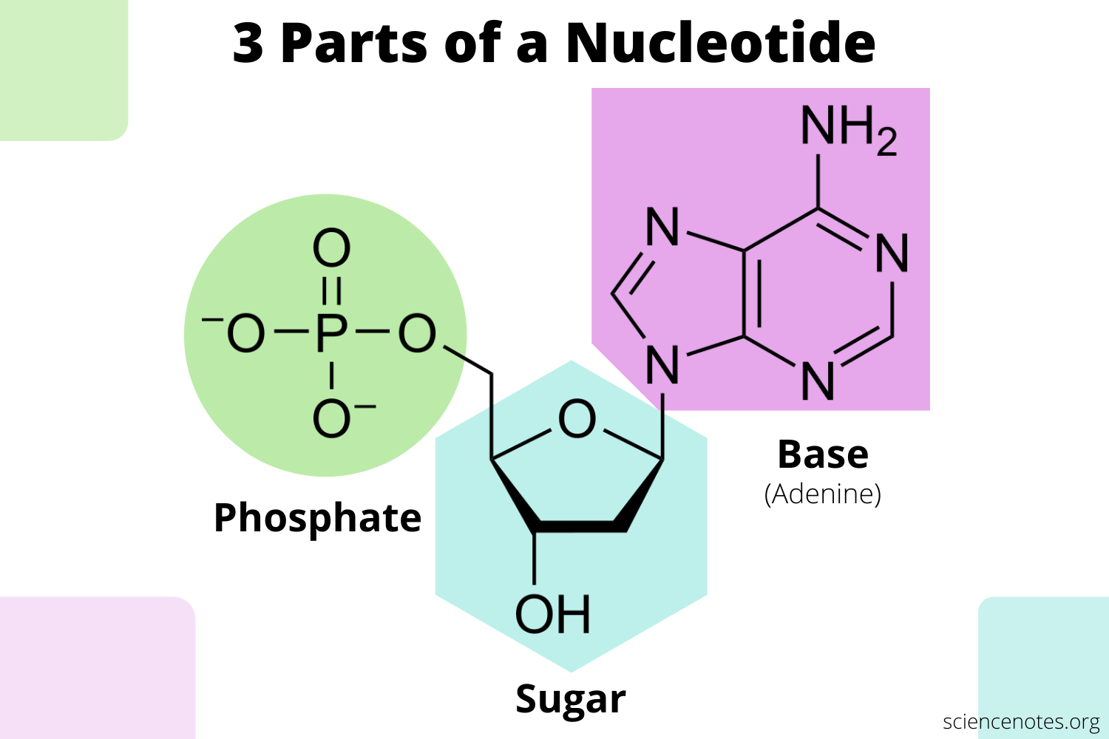
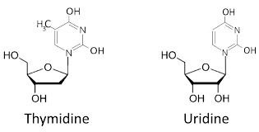
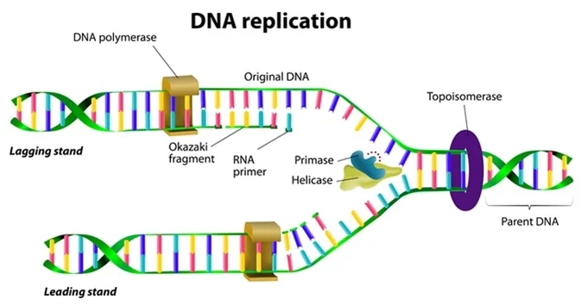
5-FU inhibitor
Thymidylate Synthase
(Science Notes)
How do we convert Uridine to Thymidine?
We need all sorts of different nucleotides for DNA replication!!

Slide 4
5-FU
Binds to Cancerous Cells (Great!)
Binds to Normal Cells
(Oh No!)
Hmm…. what if we could create a drug that only binds to cancerous cells and dodges our healthy cells??
Toxic Therapeutic

Slide 5
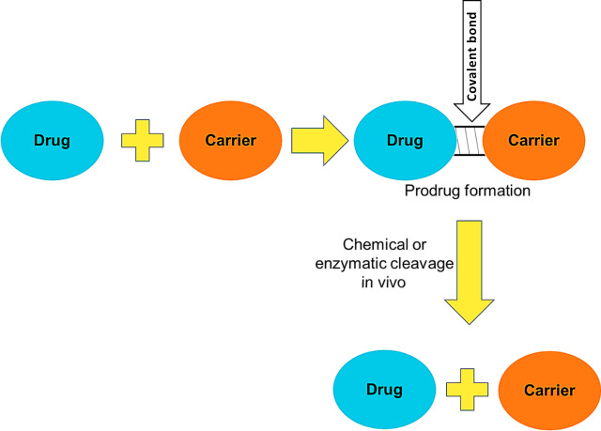
5-Fluorocytosine (5-FC) is an analogue which is used instead of 5-FU.
5-FC is bound to a carrier protein and this complex together is known as a prodrug
Prodrug goes to target membrane where it is then converted to the active form of the drug by CD-AV component
Choudhary et. al (2020)

Slide 6
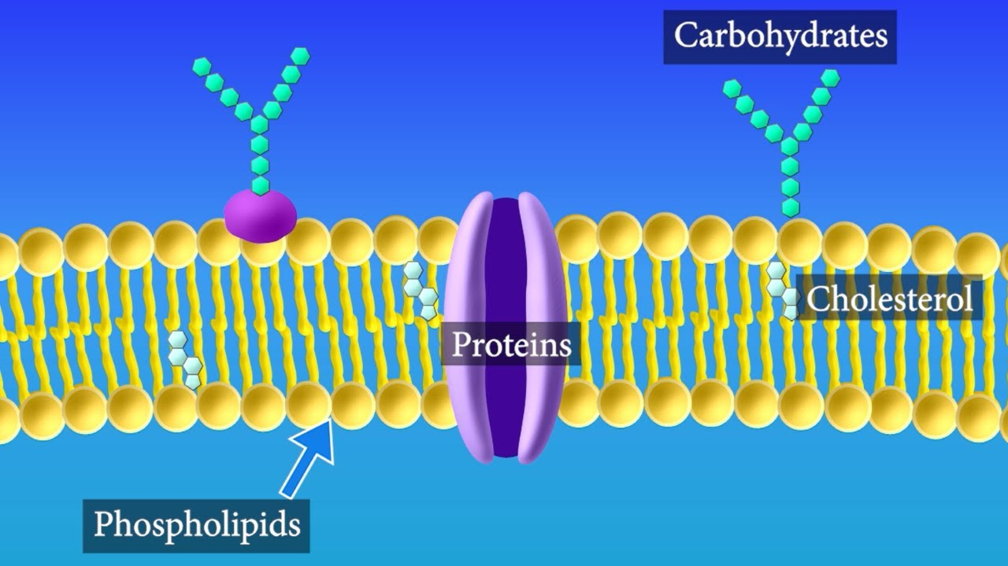
Converts 5-FC to 5-FU
5-FC
Annexin V Protein (AV)
Cytosine Deaminase (CD)
Binds to
Responsible for binding phosphatidylserine (one of the phospholipids in the cell membrane)
If you don’t add any CD-AV Complex with 5-FC to convert it to the active 5-FU can have it any effect on cancer cells?

Slide 7
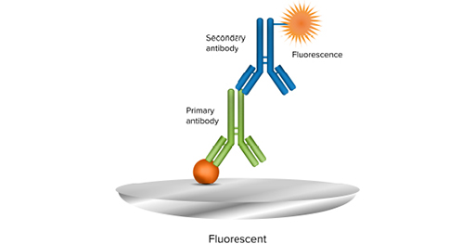
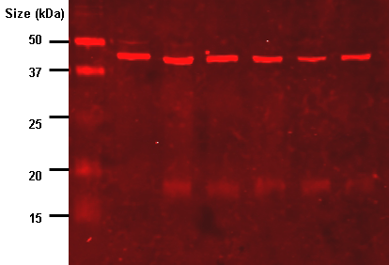
Uses anti-antibodies (antibodies are “anti” to the antigen they bind) to detect proteins
We can detect whether cells are viable or not by seeing if a band shows up on the immunoblot
If a band shows up, then it means the cells were not killed by our drug complex and are still viable
(Molecular Devices)
(Wikipedia)

Slide 8
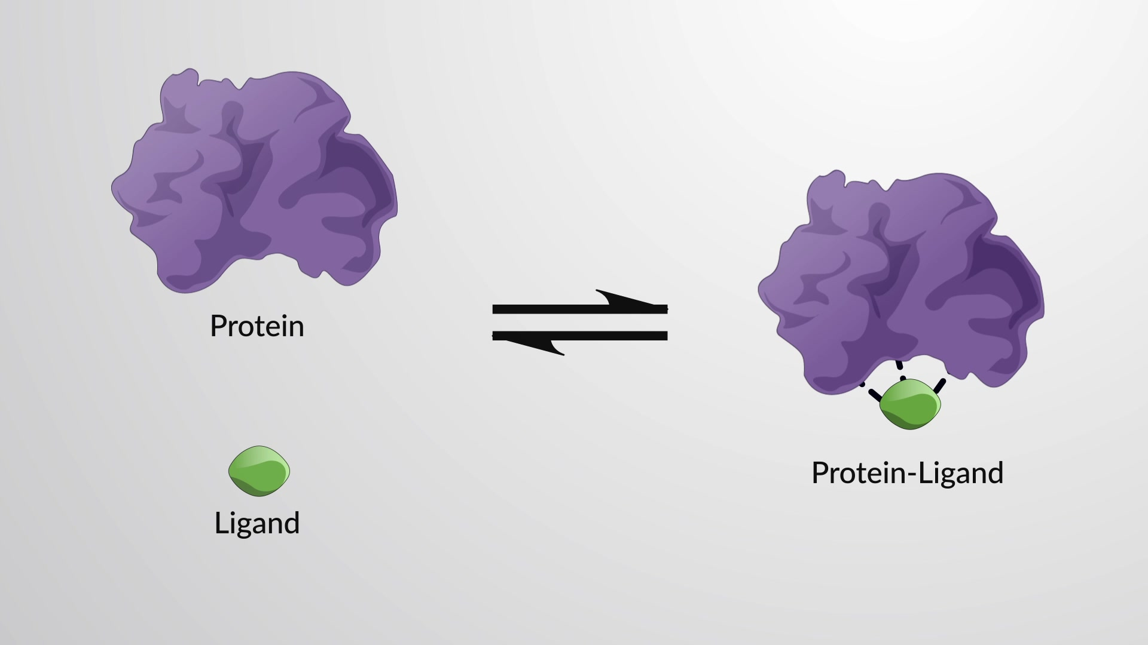
Dissociation Constant (Kd) tells you how often a ligand dissociates from the protein
Less dissociation aka lower Kd means stronger affinity or binding between protein and ligand
We want the strongest binding possible between our prodrug complex and the cancer cell membranes
(Jove)

Slide 9
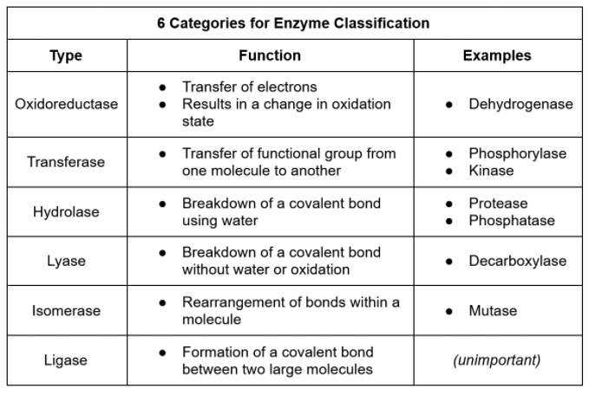
(Jack Westin)

Slide 10
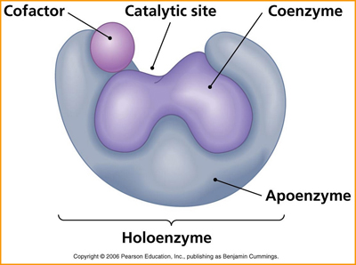
Coenzyme
Non-protein organic groups that bind to enzyme and aid its function
Cosubstrate
Binds and dissociates from enzyme
Prosthetic group
Must be bound to enzyme at all times for enzyme to work
Cofactor
Inorganic species that aids enzyme function
Usually metal ions
Magnesium (Mg)
Zinc (Zn)
Iron (Fe)
Apoenzyme (lacks coenzymes/cofactors)
Holoenzyme (has cofactors/coenzymes)
(Pearson Education)

