Slide 1
Serotonin Biology Passage Walkthrough
By Siddharth Venigalla
*Disclaimer* - I do not own the rights to any of these images, all images are cited

Slide 2
Icebreaker
Name
School
What’s your favorite movie?

Slide 3
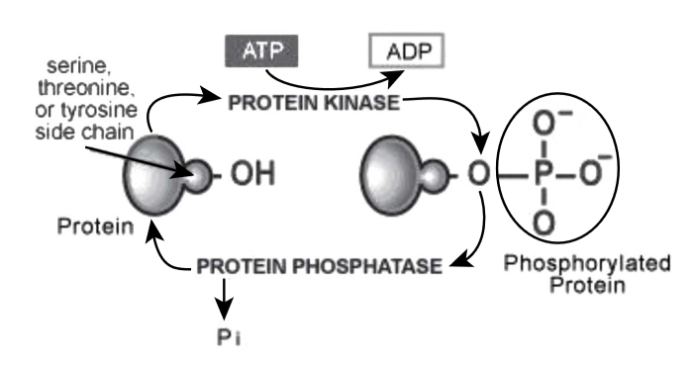
(Chegg)

Slide 4
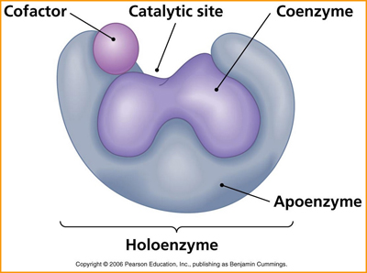
Coenzyme
Non-protein organic groups that bind to enzyme and aid its function
Cosubstrate
Binds and dissociates from enzyme
Prosthetic group
Must be bound to enzyme at all times for enzyme to work
Cofactor
Inorganic species that aids enzyme function
Usually metal ions
Magnesium (Mg)
Zinc (Zn)
Iron (Fe)
Apoenzyme (lacks coenzymes/cofactors)
Holoenzyme (has cofactors/coenzymes)
(Pearson Education)

Slide 5
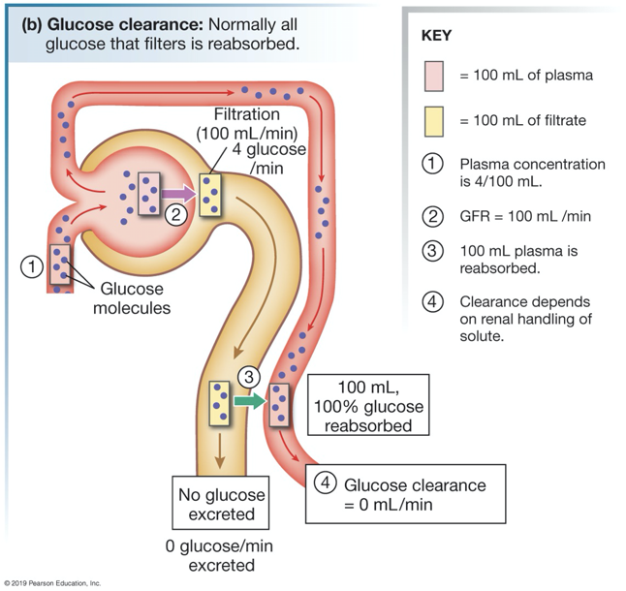
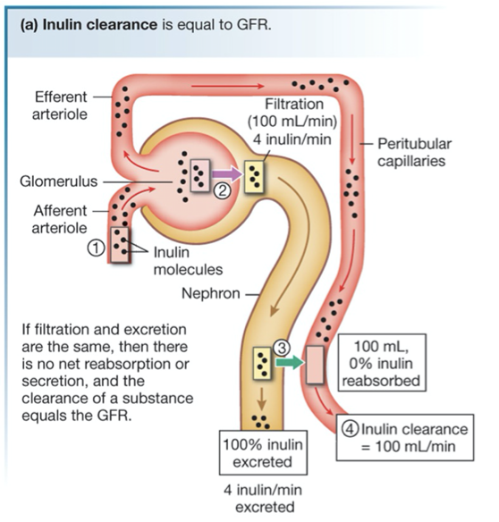
Bad marker of renal blood flow
Great marker of renal blood flow
(Pearson Education)
-Substances that are not reabsorbed and mostly filtered/secreted have high clearance and are good markers of renal blood flow
-By not reabsorbing the stuff getting pushed out at the glomerulus, you’re getting an accurate marker of how much blood is flowing to the kidney and how much filtration occuring
When blood enters the kidney, substances are filtered and pushed out into the glomerulus and travel through the kidney ducts (this is called filtration)
Some gets moved back into the blood (reabsorption) and some from the blood is sent into the kidneys for excretion (secretion)

Slide 6
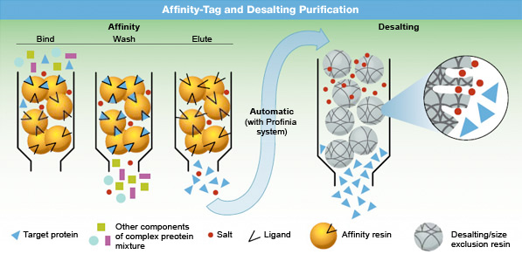
(Bio-Rad)
Protein binds ligand
You attach the ligand to a bead so the protein will bind to the ligand and be separated from the mixture
You then use a salt to kick the protein off the ligand beads and isolate it

Slide 7
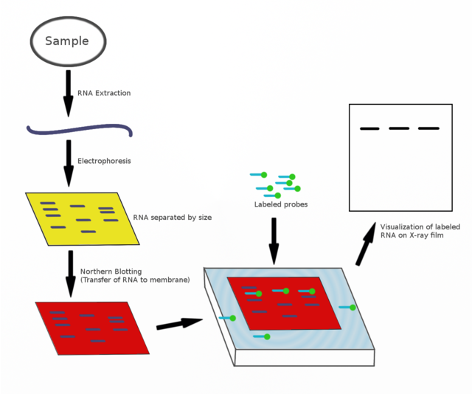
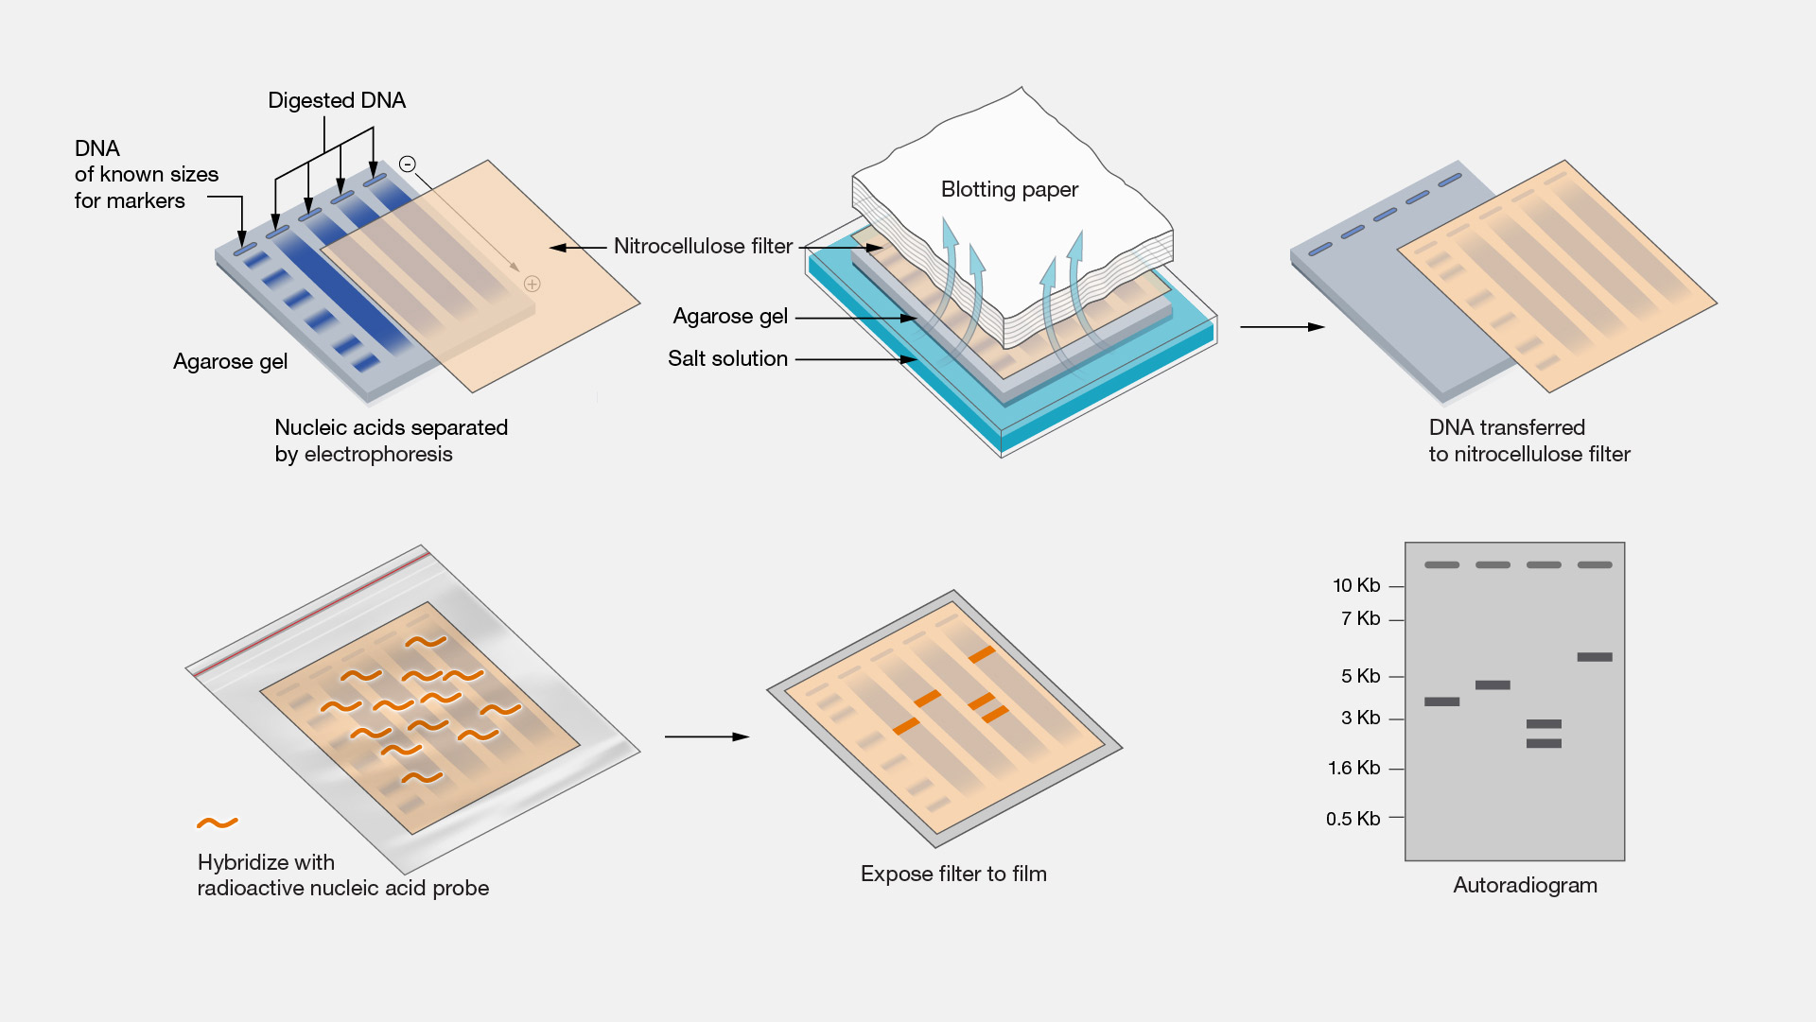
(National Human Genome Research Institute)
Northern Blot
Detects RNA
Separate RNA fragments using gel electrophoresis
Transfer RNA to blotting membrane and label using probes
(Wikipedia)
Southern Blot
Detects DNA
Separate DNA fragments using gel electrophoresis
Transfer DNA to blotting membrane and label using probes

Slide 8
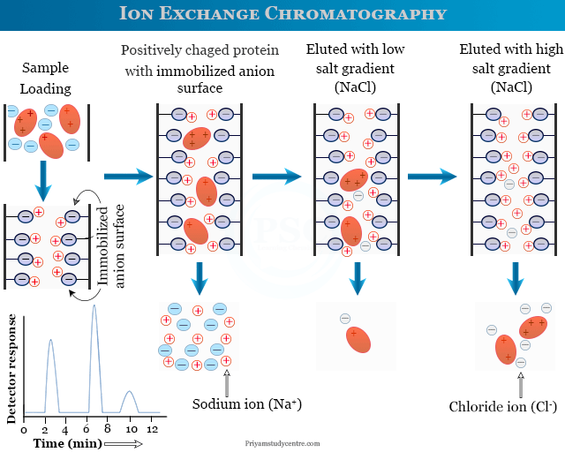
Positively or negatively charged beads attract negative proteins or positive proteins respectively, used to separate proteins from mixture
After protein is stuck to bead, you use salt to kick it off and isolate it

Slide 9
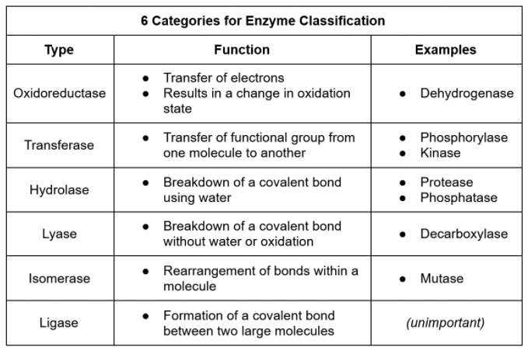
(Jack Westin)

Slide 10
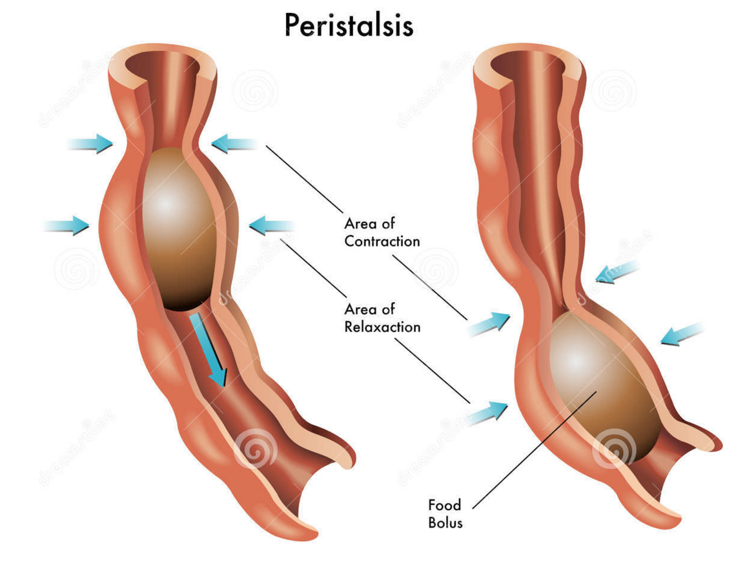
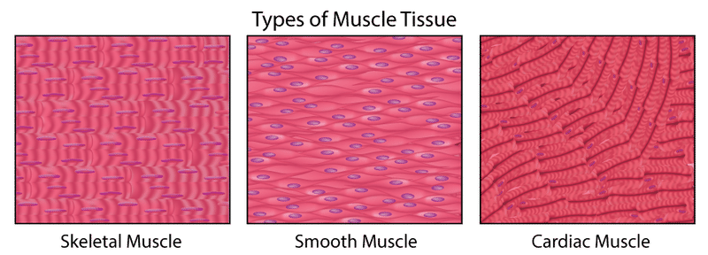
(Libre Texts Biology)
Cardiac and skeletal muscle are striated (have stripes)
Skeletal muscle is multinucleated (multiple nuclei) whereas cardiac and smooth are uninucleate (one nuclei)
Smooth muscle is not striated (no stripes)
(PMG Biology)
SMOOTH MUSCLE (THINK HEART, DIGESTIVE TRACT) CONTRACTION IS INVOLUNTARY, SKELETAL MUSCLE CONTRACTION IS VOLUNTARY

