Slide 1
Ultrasound and the Eye Passage Walkthrough
By Siddharth Venigalla
*Disclaimer* - I do not own the rights to any of these images, all images are cited

Slide 2
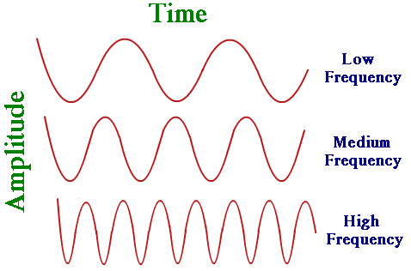
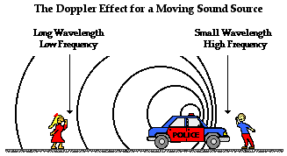
(The Physics Classroom)
In Doppler effect, the wave source is moving which alters the perceived frequency (observed frequency) such that is shifted from emitted frequency
If an object is moving towards you, each successive peak takes less time to get to you which increases the perceived frequency
If the object is moving away from you, each successive peak takes longer to reach you which decreases, stretches out distance between peaks so that observed frequency is less
(Physics Stack Exchange)
Frequency of a wave is how many waves pass through a certain point during a second
Short distance between peaks means higher frequency!!!
Every wave has a set, characteristic frequency think x-rays vs color waves

Slide 3
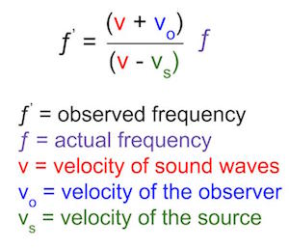
(The Physics Classroom)
(Study.com)
You can calculate the frequency of the observed wave from the wave emitted from the source using the doppler formula
When object is moving towards you, Vo (velocity of object) and Vs (velocity of source) are positive and when object is moving away Vo and Vs are negative

Slide 4
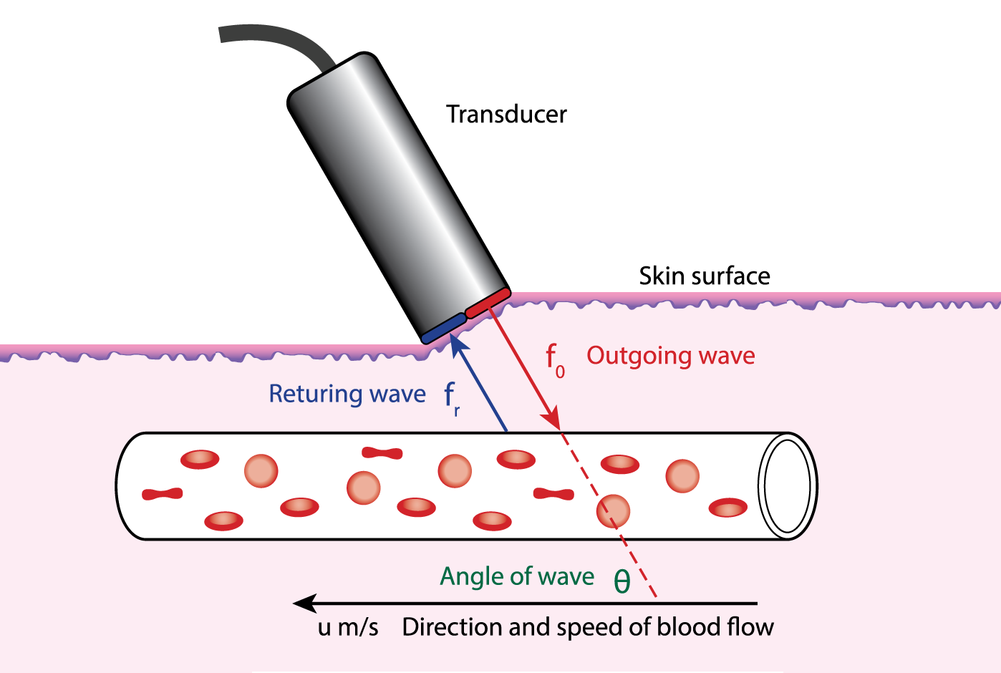
Doppler Ultrasound measures the velocity of flow of blood in your body based on the shift in the frequency emitted by a transducer and the observed frequency of the returning wave that it senses
The frequency of the returning wave will be different due to doppler effect since the blood will be moving away or towards the transducer
(Esp Inc)

Slide 5
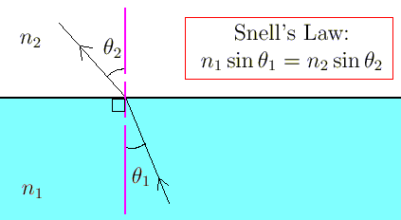
When wave enters new medium, it bends away from normal or towards normal depending on the index of refraction
Entering a medium with lower index of refraction means the angle from normal will increase, wave will bend further from normal
To get the best image in ultrasound, you want most of the waves to return the probe
Refraction will alter the direction of the waves such that the waves return in a different direction
Index of refraction will alter way waves travel and return
Angle of incidence will alter which direction waves return
If tissue absorbs waves then less will return to probe
The velocity of the incoming wave does not alter reflection or refraction so it will not affect image res

Slide 6
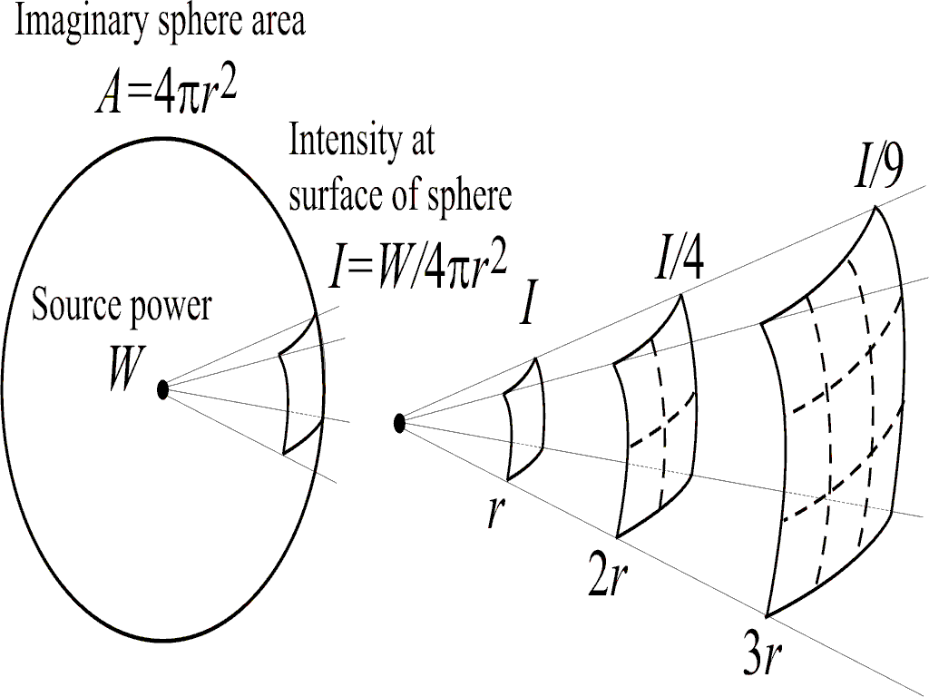
The intensity of wave is inversely proportional to the square of the distance at which it is received
Therefore, if you double the distance an object from a source, then you will have 1/4th the intensity of the wave observed
(Institute of Sound and Vibration Research)

Slide 7
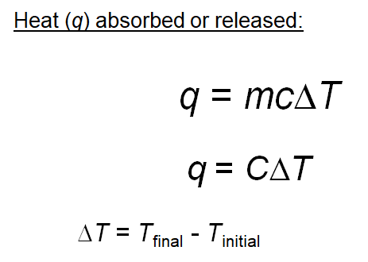
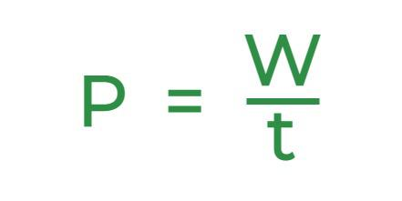
(Geeks for Geeks)
Power is work (joules) divided by time (seconds)
The heat capacity (C) of the object tells you how much energy (Q) you need to raise its temperature (T)
Multiply the heat capacity by change in temperature to figure out the energy transferred

