Slide 1
Frictitious and Clock Passages Walkthrough
By Siddharth Venigalla
*Disclaimer* - I do not own the rights to any of these images, all images are cited

Slide 2
Icebreaker
Name
School
Who’s your favorite musical artist?

Slide 4
N
Friction
mgcos(θ)
W
mgsin(θ)

Slide 5
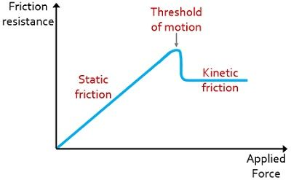
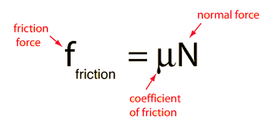
Friction always OPPOSES motion, acts in the opposite direction
Two Types of Friction
Static
No motion between the point of contact of an object and the surface
Kinetic
Motion between an object and the point of contact of the surface
A block sliding down the incline is experiencing what type of friction?
(Circuit Globe)
The coefficient you use in the equation depends on if there is motion between the object and surface (either static coefficient or kinetic coefficient)

Slide 6
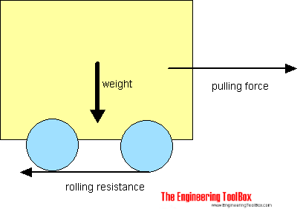
At the point of contact between wheel and surface, there is no movement
Therefore, rolling friction is known as a form of static friction
Rolling friction slows down the object but it is different from typical sliding friction (kinetic, think book against table) in that it is static

Slide 7
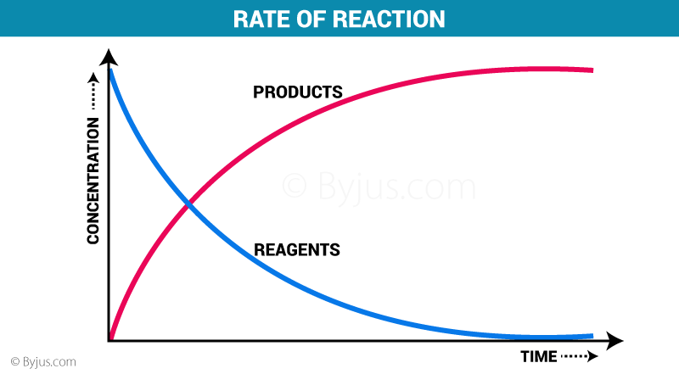
(Byjus.com)
(Quora)
X + 2Y -> A + 2B
ΔA/t is the reaction rate OR
½ ΔB/t
OR
-ΔX/t OR
-½ ΔY/t

Slide 8
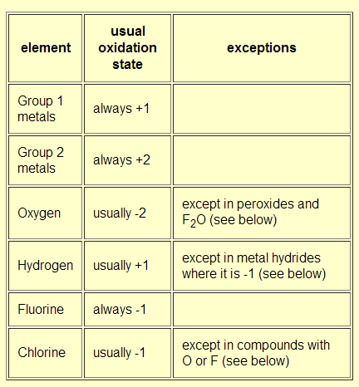
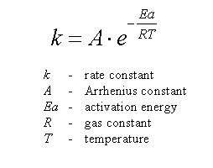
(Upenn.edu)
The rate constant (k) in the rate law is calculated using the Arrhenius equation
(Chemistry Stack Exchange)
Every element has something called an oxidation state. The oxidation states of each element in a compound add up to the overall charge of a compound

