Slide 1

Collagen Disorders Passage Walkthrough
By Siddharth Venigalla
*Disclaimer* - I do not own the rights to any of these images, all images are cited

Slide 2
Icebreaker
What is your favorite ice cream flavor?

Slide 3
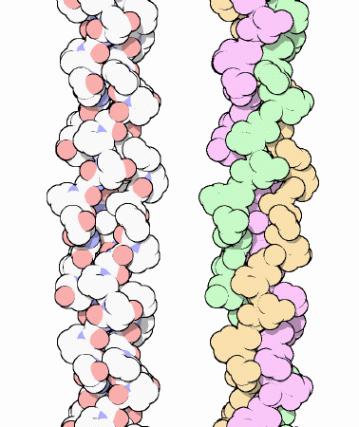
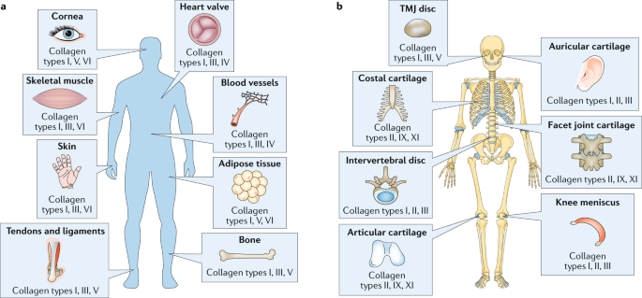
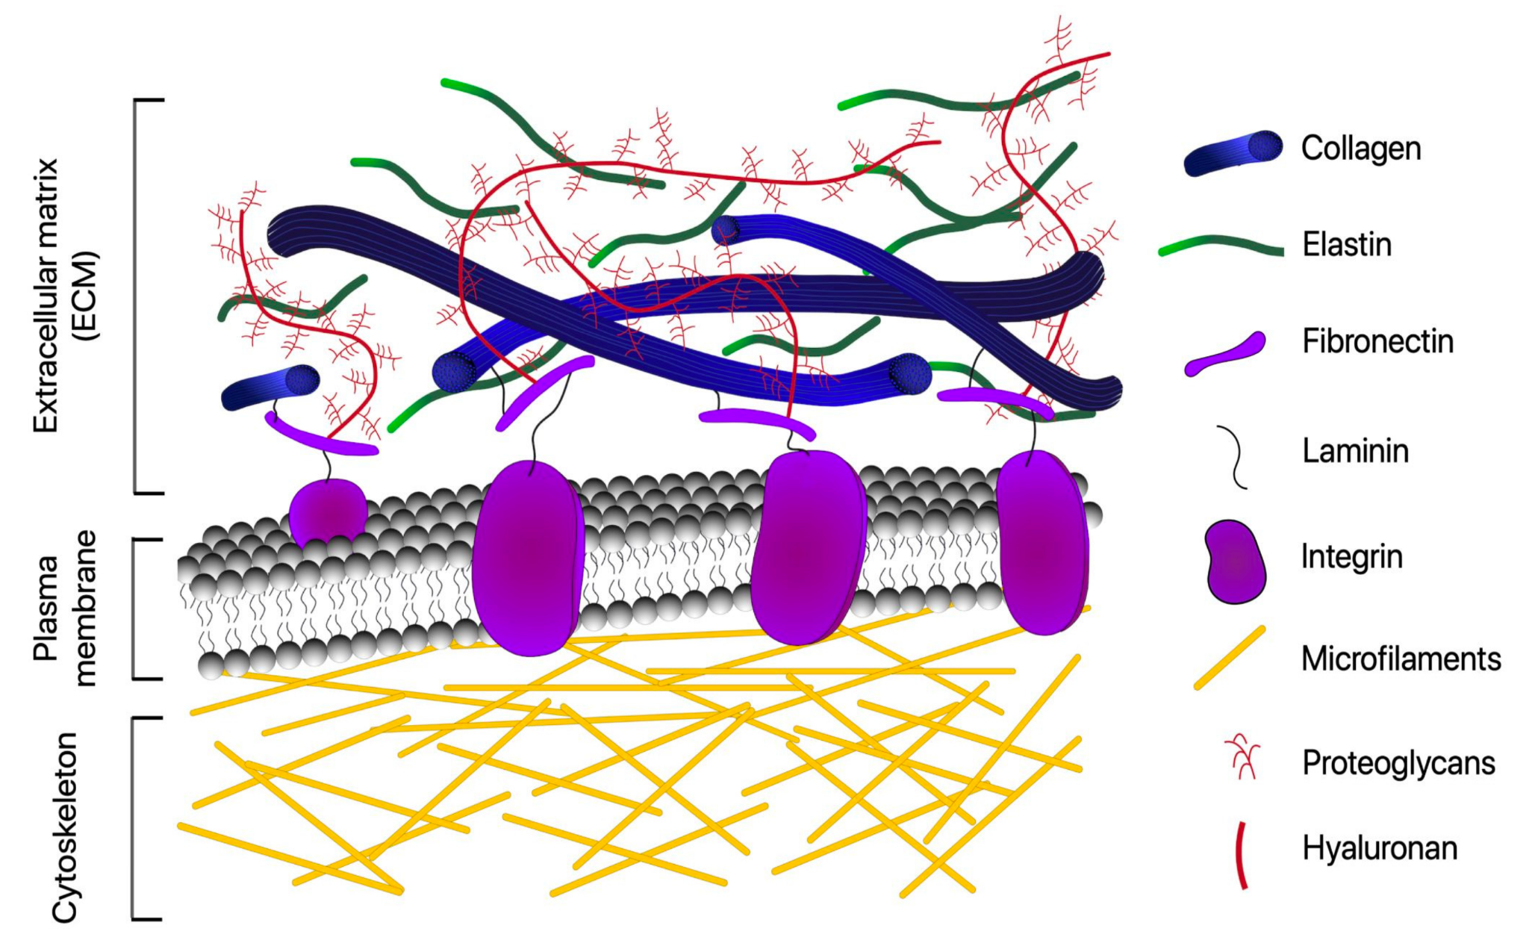
(Nature)
Collagen is a structural protein in extracellular matrix
Found in connective tissue all over the body, mutations in collagen protein cause harm in body
Protein is a triple helix, think string cheese!
(Protein Data Bank)
(Poole et. al)

Slide 4
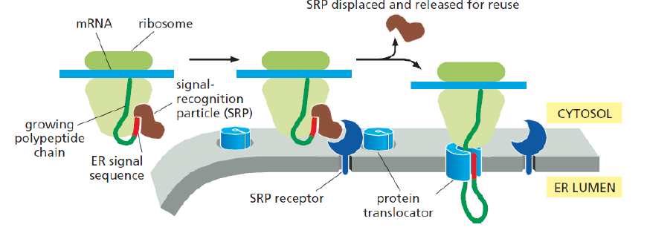
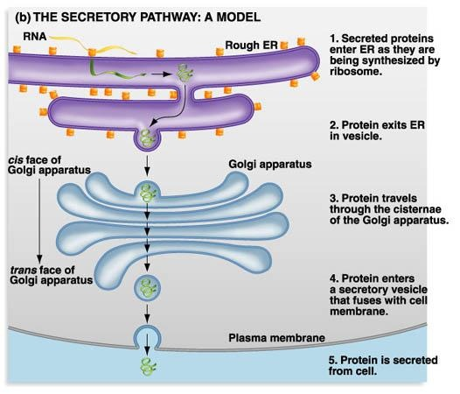
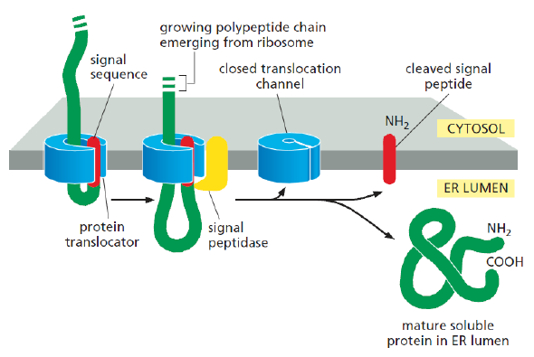
(Wize Prep)
(Biology 12 PLO)
Collagen is a secretory protein
It is translated as preprocollagen in the Rough ER
Its signal sequence is chopped off in the ER at which point it becomes procollagen
Procollagen undergoes glycosylation, and folding which are known as post-translational modifications in the ER

Slide 5
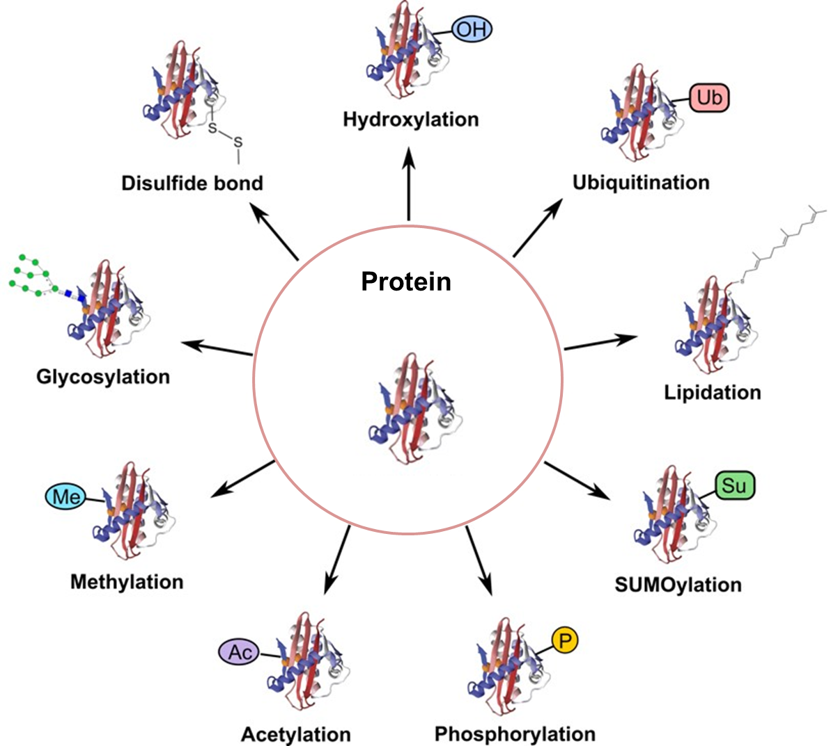
After translation by ribosomes, proteins are often modified in what are called post-translational modifications
Collagen precursors preprocollagen is modified in the Endoplasmic reticulum with hydroxylation and glycosylation
It also folds to eventually form procollagen
The procollagen is then sent out of the cell after moving through the Golgi apparatus
While you can do alot of post-translational modifications, one thing you CANNOT do is insert an extra residue into the primary sequence after the protein has been translated
(Creative Proteomics)

Slide 6
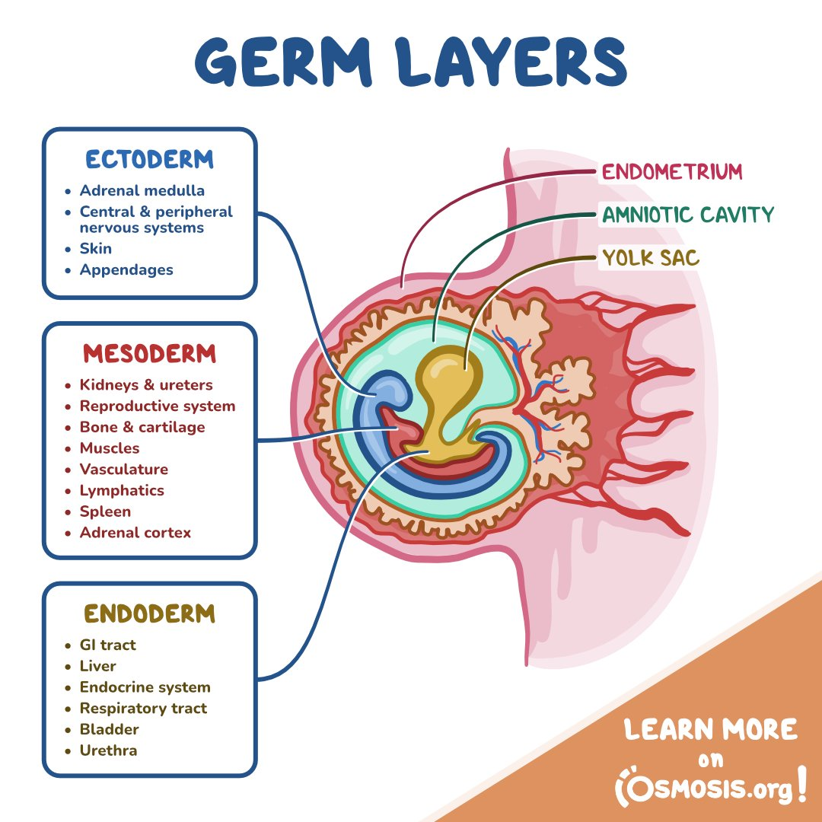
In the developing embryo, there are three germ layers from which all the structures in the body descend from
You need to know which structures come from each germ layer for the MCAT!!

Slide 7
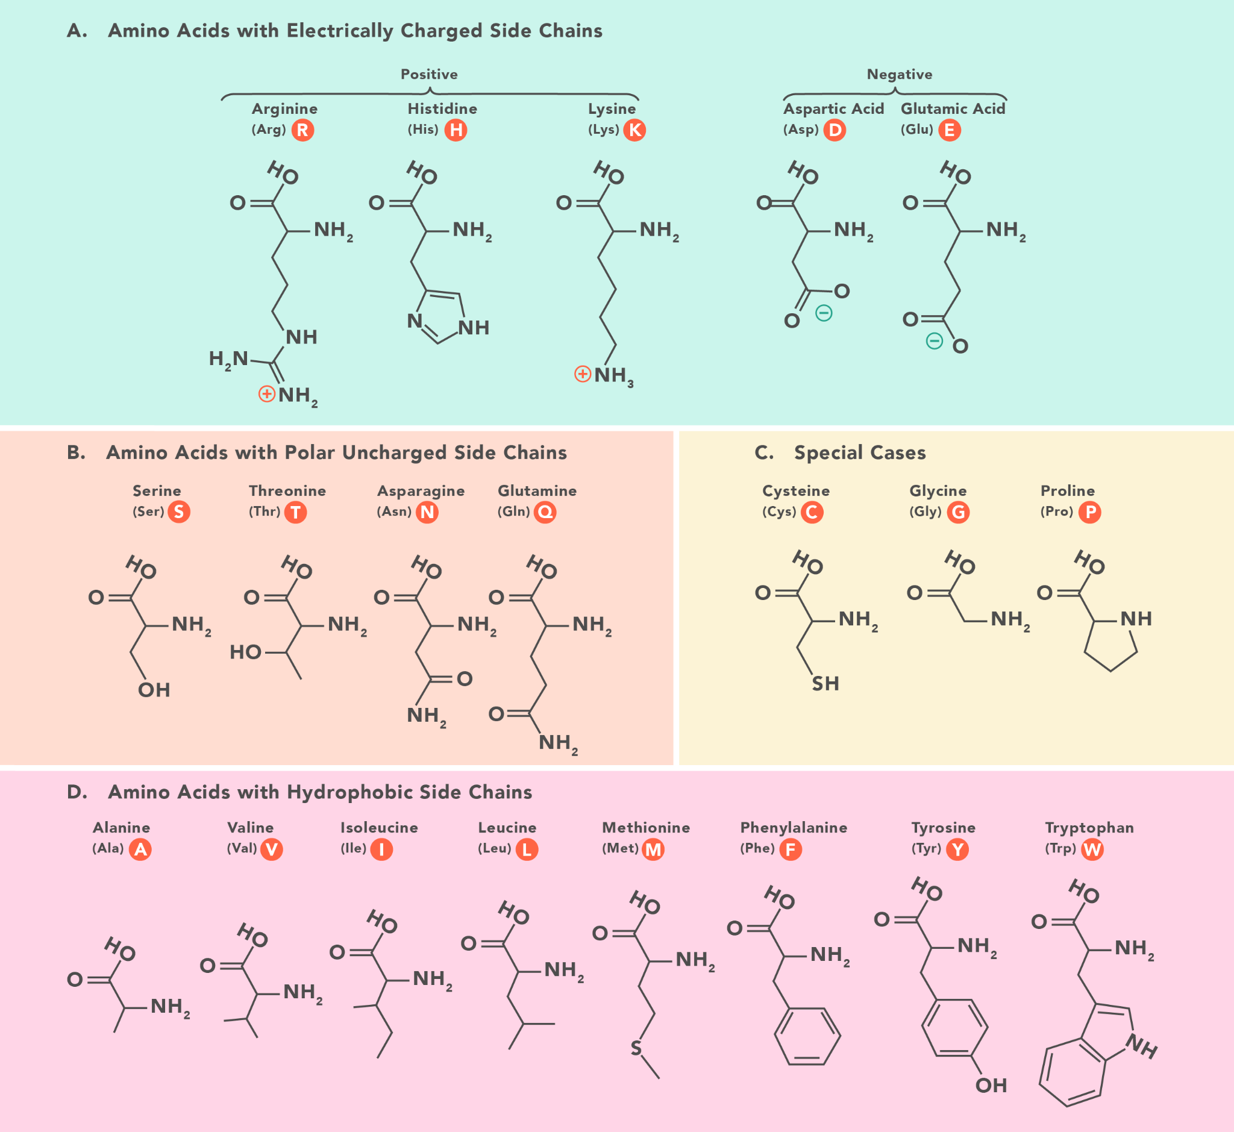
Bulky amino acids usually have a phenyl group in them such as phenylalanine, tyrosine, tryptophan
Amino acid residues can be charged such that their interactions determine the shape of a protein
For proteins to interact with one another you don’t want repulsion aka you don’t want similarly charged residues near each other
  You can glycosylate or hydroxylate a amino acid residue to CONCEAL its charge and get rid of these repulsions that could harm protein interactions
(Technology Networks)

